Slide 1
Neural Networks
CSCI 601-471/671 (NLP: Self-Supervised Models)
https://self-supervised.cs.jhu.edu/sp2025/

Slide 2
How was HW1
With a show of hand, which one best applies to you:
It was smooth sailing through things I knew; my hamster nearly finished it.
it was familiar stuff but I had to learn or refresh a few things.
It was like shoveling snow in the middle of a blizzard, it just kept getting worse
It was so challenging, it felt like climbing Mount Everest with slippers on.
Notes:
Option 2 is the target level.
We will have 6 more assignments with similar caliber to make sure that y

Slide 3
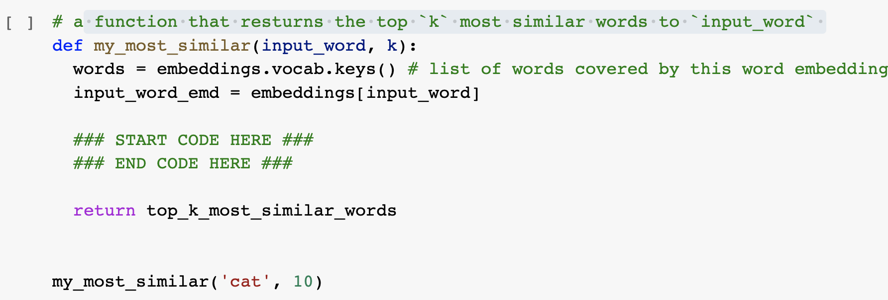
“Can I use external libraries?” No, unless specified!
Use the basic Python functions (no external libraries), unless explicitly specified.
In almost all places, you’re not expected to write more than 3-4 lines of code.

Slide 4
“I can’t install ….”
It may be frustrating to deal with software dependencies…
But it’s [going to be] part of your job’s reality …
Embrace it! 🤗

Slide 5
HW2 is released
Have you seen it?
Due next Tuesday noon.
Feels like a long time away?
it’s due in 120 hours!

Slide 6
Recap: Language Modeling
Language Modeling: estimating distributions over language.
One approach we previously saw: counting word co-occurrences.
Pro: easy — just count!
Con: difficult to scale to longer context due to the sparsity challenge.
Another approach:
Using a learnable function that can estimate word transition probabilities.
Now: What are these learnable functions and how can we train them.
Notes:
We should probably start with a recap of what we've learned so far. Last time, we discussed language modeling, which we defined as the task of estimating some distribution over natural language. We aim to build a probabilistic model that predicts what will happen within a context of natural language. The first language model we learned about was based on counting word co-occurrences given a context of length n or n-1. We wanted to see the transition probability to the next token. We observed that while this method is easy to compute over large sets of documents, it doesn't scale well to longer contexts due to sparsity issues. The longer the context, the sparser the frequencies become, which means they don't capture long-range dependencies. This is a problem for natural language understanding because what we say now often depends on what we said earlier.
The alternative we considered was moving away from just counting and using statistical models to learn transition probabilities between contexts and the next token. This brought us to the question of what these learnable functions are and how we can train them. This is where the discussion of neural networks comes in, as they will serve as our learning functions. In this chapter, we will set aside the discussion of language modeling for a couple of sessions to focus on understanding neural networks, how to train them from both a theoretical and empirical perspective, and best practices for training.

Slide 7
Neural Networks: Chapter Plan
Defining neural networks (feedforward nets)
Neural nets: brief history
Algebra background for training neural nets
Training neural networks: analytical backpropagation
Backprop in practice
Chapter goal: Get comfortable with thinking, designing and building neural networks — very powerful modeling tools.
Notes:
First, we'll define what neural networks are,
discuss their origin and history,
and then do a recap of algebra and statistical learning.
And using this algebra, we will delve into training neural networks.
And finally we'll switch gears to discuss practical lessons about training them in practice.
The goal of this chapter is to become comfortable with various notions around neural networks and training. This segment will be useful whether you work with natural language in the future or not, as the same ideas will apply across many different modalities.

Slide 8
Feedforward
Neural Nets
Notes:
Let's talk about feedforward neural networks.

Slide 9
Neural Networks
What are neural networks?
Functions that take an input and produce an output.
What is inside this box?
NN
NN
Video
Caption
Text
Image
NN
Game state
Action
Notes:
So broadly, we define neural nets as functions that map from one space to another.
These functions can, for example, map videos to captions or text to images, or text to images, and so on.
They're very versatile.
Given this high-level understanding, we want to open the box and see what's inside.
Merge with:
So, what is a neural network? Let's define that. Neural networks are functions that map input in some space to output in another space. The input could be videos to text, or text to images. They're versatile and flexible in creating many mappings. Now, what's inside them?

Slide 10
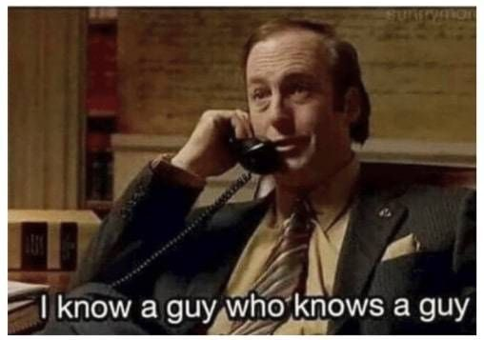
What’s Inside Neural Nets?
Notes:
What’s inside neural nets is best capture by a famous quote by Saul Goodman, that …
The best summary I found for describing what's inside a neural network is this famous meme or quote by Saul Goodman, who said, "I know a guy who knows a guy." That's the best summary for what's inside a neural network.

Slide 11
Feedforward networks
This is a particular class called “feedforward” networks.
Cascade neurons together
[Slides: HKUST]
Notes:
Let's unpack Saul Goodman's intuition.
Inside a neural network, you have a bunch of neurons connected to each other.
Each neuron receives inputs and passes signals to the next neuron.
On the first layer, you have the inputs to your neural network. These inputs get transformed through a series of weight multiplications and are passed on to individual nodes.
We'll define what those nodes are, and how they processes the input signal and passes it on to the next layer.

Slide 12
Feedforward networks
Inputs multiplied by initial set of weights
[Slide: HKUST]
Notes:
Visually, we start from the input, the values of which get transformed and passed on to the first layer of neurons.

Slide 13
Feedforward networks
Intermediate “predictions” computed at first hidden layer
[Slide: HKUST]
Notes:
The first later, similarly, process the input,

Slide 14
Feedforward networks
Intermediate predictions multiplied by second layer of weights
Predictions are fed forward through the network
[Slide: HKUST]
Notes:
And pass it on to the next layer,

Slide 15
Feedforward networks
Compute second set of intermediate predictions
[Slide: HKUST]
Notes:
And so on.

Slide 16
Feedforward networks
Multiply by final set of weights
[Slide: HKUST]
Notes:
Visually, we start from the input, the values of which get transformed and passed on to the first layer of neurons. They process the input, pass it to the next layer, and so on, until the final layer makes a prediction.
Each node knows the next node it needs to pass the signal to. If you have questions or if anything is confusing, just ask.

Slide 17
Feedforward networks
Aggregate all the computations in the output
e.g. probability of a particular class
[Slide: HKUST]
Notes:
until it reaches the final layer, where the neural networks makes a prediction.
Notes that in this architecture, each node knows:
the ancestor nodes from which it receives signals
and the descendant node it needs to pass the signal to.
Now what are the parameters or design choices for this neural network?

Slide 18
Feedforward networks
All the intermediate parameters are ought to be learned.
Weights to learn!
Weights to learn!
Weights to learn!
[Slide: HKUST]
Notes:
The arrows that transmit the signals are weighted here.
These weights are essentially the parameters that needs to be learned for changes a neural network’s behavior or a specific objective.
We will see algorithmic approaches for tweaking these weights.

Slide 19
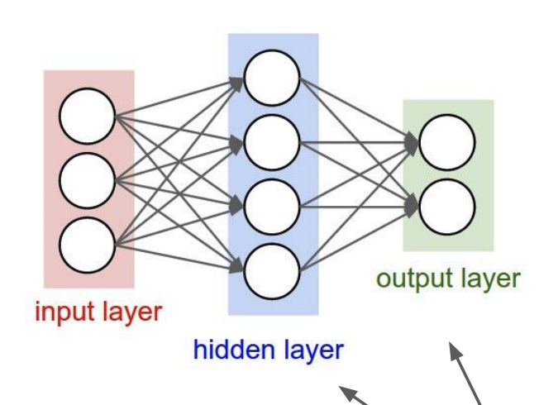
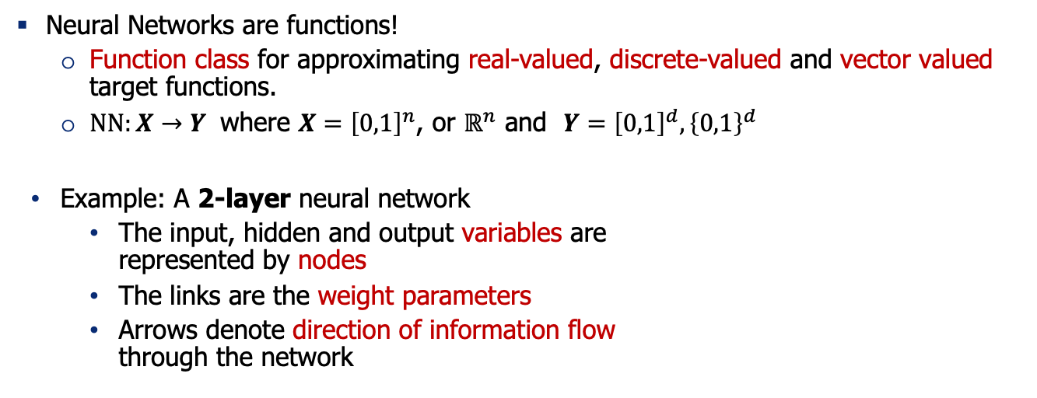
Feedforward Neural Network
Neural Networks are functions!
Function class for approximating real-valued, discrete-valued and vector valued target functions.
$NN:X→Y$ where $X={\left[0,1\right]}^{n}$, or $ℝ^{n}$ and $Y={\left[0,1\right]}^{d}, {\left\{0,1\right\}}^{d}$
Example: A 2-layer neural network
The input, hidden and output variables are represented by nodes
The links are the weight parameters
Arrows denote direction of information flow through the network
Notes:
Let’s see a slightly more formal definition of neural nets by adding some math.
Again, we defined a neural network as a function that maps an input from space X to an output in space Y.
Your inputs can be discrete or continuous values from some input space, and your output can also be discrete or continuous in some high-dimensional space.
For example:
This is a two-layer network with one hidden layer.
Notice from now on, we’re going to call every layer between the input and output layers as a “hidden layer”.
You may have one hidden layer or many – that is a design choice.

Slide 20
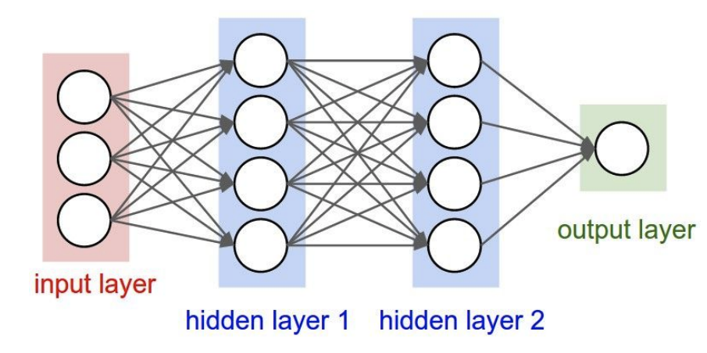
Neural Network: Making it bigger
Add more layers, or wider layers!
A 2-layer neural network A 3-layer neural network
Notes:
Similarly, this is a three-layer network.

Slide 21
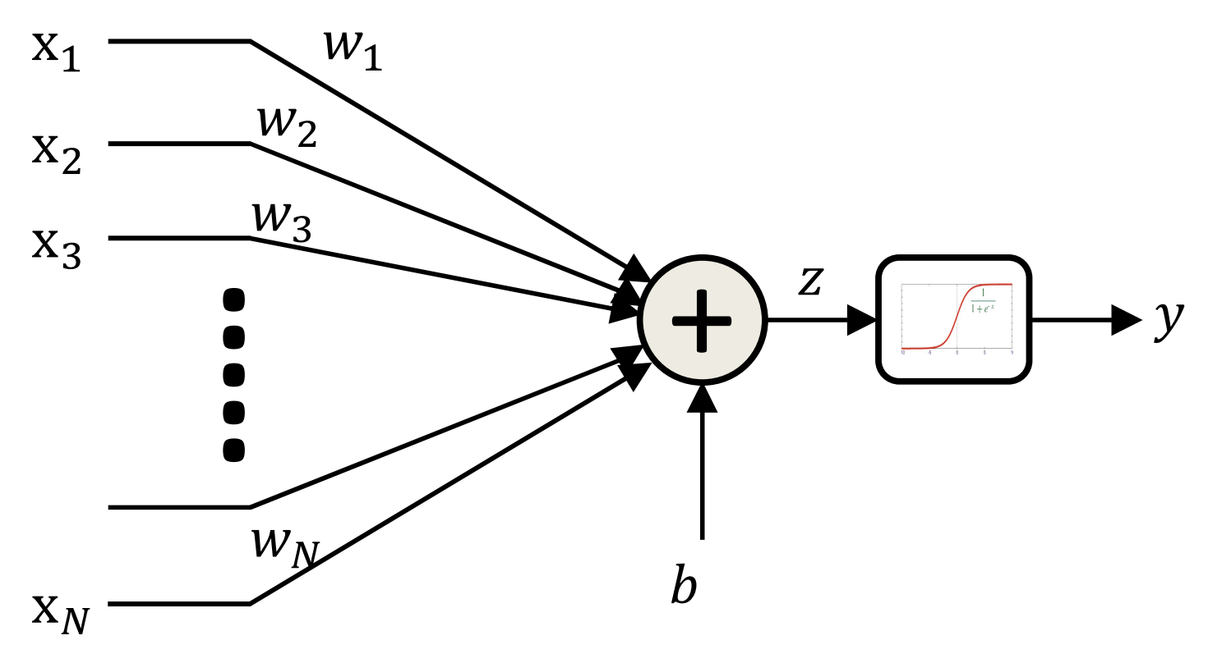
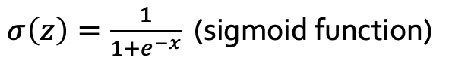
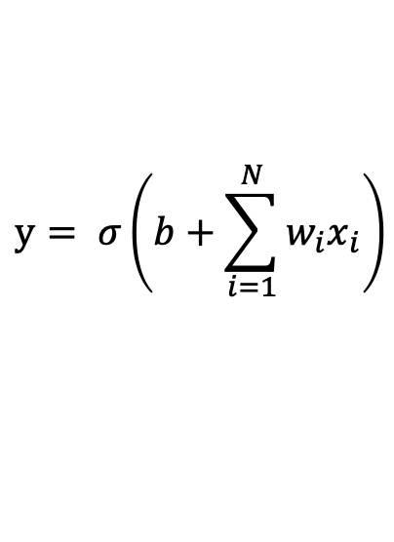
Feedforward Neural Network: The Neurons
A mathematical model of neuron is “perceptron”.
It consists of a non-linear function that “fires” if the affine (linear) function of inputs is above a threshold.
$$y= σ\left(b+\sum_{i=1}^{N}{w_{i}x_{i}}\right)$$
$σ\left(z\right)=\frac{1}{1+e^{−x}}$ (sigmoid function)
Notes:
So far we've talked about the overall architecture, but we haven't defined what's inside each of these circles.
That's the element I defined as a neuron.
A neuron receives a bunch of signals and emits signals to the next layer.
These edges are weights that are denoted as w1 to wn for a sequence of inputs from X1 to Xn.
Then there is an addition function that adds all these inputs and then passes it to a nonlinearity.
Let me show this in mathematical form:
you receive a sequence of x's as inputs, weight them based on the weights of these edges, sum them, and pass them to a nonlinearity function
Merge:
So, what exactly is inside those circles? We've discussed the overall architecture, but we haven't defined what's inside each circle. The precise term for the circle is a perceptron. A perceptron is essentially a summing operation that receives multiple input values, weights them with a set of weights (W), multiplies them, sums them, and then passes them through a nonlinearity or activation function. This process gives you an output. Each circle is defined in this way.
Let me define it more formally. You receive a set of inputs (X's), weight them by their corresponding values, sum them, and add a bias term. This bias shifts the value up or down and is a fixed constant once learned. You then pass it through a nonlinearity function, which I call Sigma. Sigma is just an activation function, a nonlinearity. For example, if the input values are very low, the output of the sigmoid will be near 0. If the input is very high, the output will be near 1. It's similar to a step function but smoother.

Slide 22
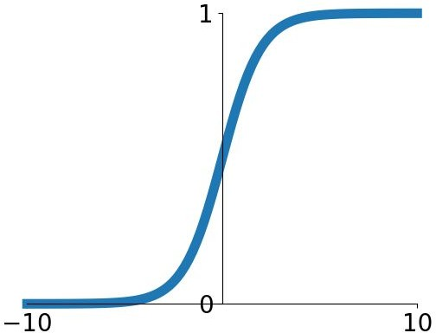
Feedforward Neural Network: The Neurons
Sigmoid is a “squashing” function.
It maps small inputs to zero.
It maps large inputs to one.
$$y= σ\left(b+\sum_{i=1}^{N}{w_{i}x_{i}}\right)$$
$σ\left(z\right)=\frac{1}{1+e^{−x}}$ (sigmoid function)
Notes:
How does this non-linearity function look like?
Here I am visualizing this sigmoid function:
This nonlinearity function applies a transformation to your input and passes that signal to the output, which is y, a single computational neuron.

Slide 23
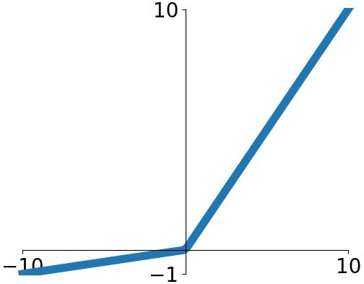
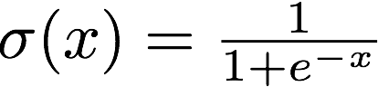
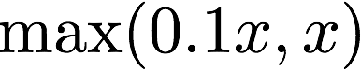
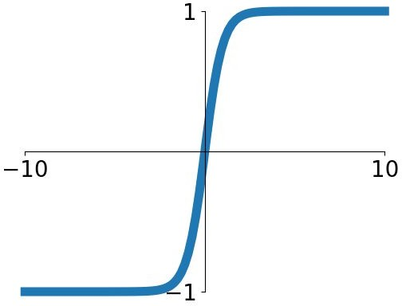
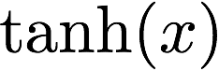
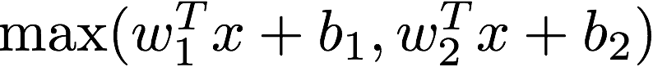
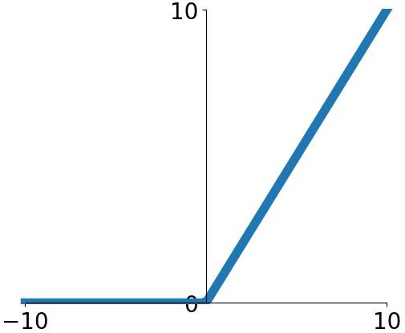
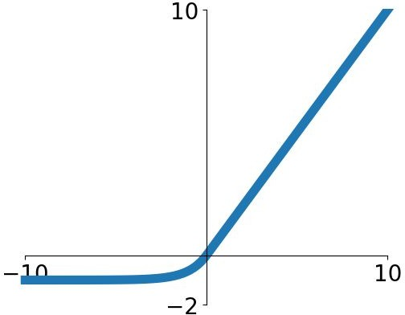
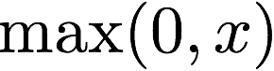
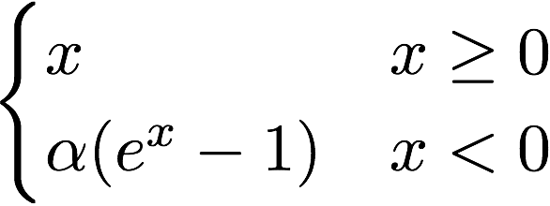
Other Activation Functions
Does not always have to be a squashing function
Sigmoid
tanh
Leaky ReLU
Maxout
ReLU
ELU
Fei-Fei Li & Justin Johnson & Serena Yeung Lecture 6 - April 19, 2018
We will talk about their pro/cons later!
Notes:
One thing to be clear about is that there are a variety of activation functions or nonlinearities.
Sigmoid is just one particular choice.
There are many different choices, and we'll talk about their pros and cons later.
For now, we'll table that conversation.

Slide 24
Terminology: Multi-Layer Perceptron (MLP)
Multi-layer Perceptron (MLP):
A feedforward network with perceptron as its nodes.
A feedforward network does not have to be an MLP.
But people sometimes use the names interchangeably! 🤷
The original MLP [McCulloch–Pitts] was based on “threshold” activation.
Notes:
By putting all these neurons together, we get an architecture commonly referred to as a multi-layer perceptron.
This is essentially a stack of perceptron (hence, the name “multi-layer perceptron”).
This is the precise name.
However, someone people just refer to them as feed-forward network because each layer processes some input and feeds it to the next layer.

Slide 25
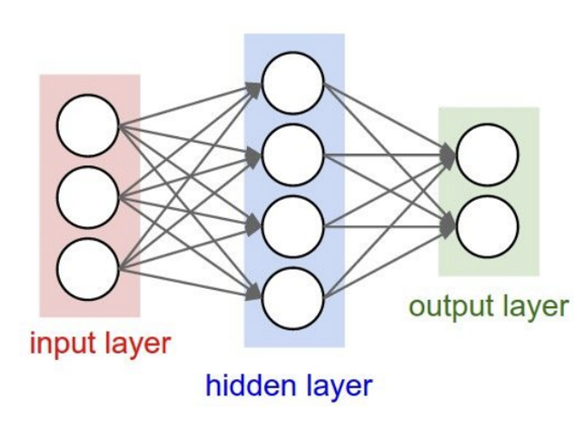
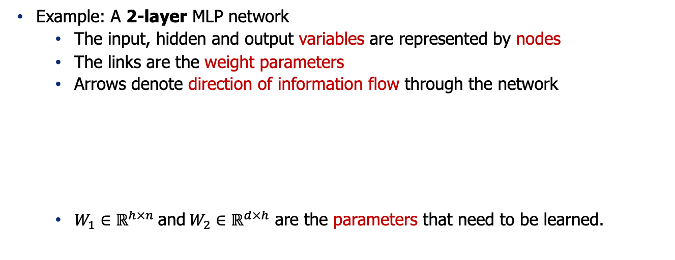
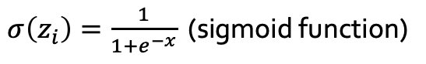
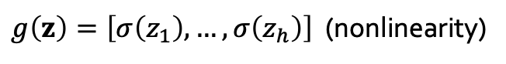
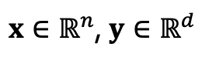
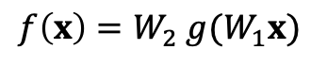
Formally Defining a 2 Layer Network
Example: A 2-layer MLP network
The input, hidden and output variables are represented by nodes
The links are the weight parameters
Arrows denote direction of information flow through the network
$W_{1}∈ℝ^{h×n} \text{and} W_{2}∈ℝ^{d×h}$ are the parameters that need to be learned.
$$f\left(x\right)=W_{2} g(W_{1}x)$$
$x∈ℝ^{n}$, $y∈ℝ^{d}$
$g\left(z\right)=\left[σ\left(z_{1}\right), …, σ\left(z_{h}\right)\right]$ (nonlinearity)
$σ\left(z_{i}\right)=\frac{1}{1+e^{−x}}$ (sigmoid function)
Notes:
Now, let's define a two-layer neural network formally.
You can define it formally like this:
you have an x that you multiply by a matrix W1, then give that to a linear function defined as g, which is a vector of sigmoid functions.
You then give the result to another matrix multiplication W2, which represents the weights of the second layer, and the result is the output.
Now this is full definition of a 2-layer neural networks in mathematical terms.

Slide 26
Quiz Time (1)
What is needed to fully specify a neural network?
Architecture (which input goes through what function etc.)
Parameters of the function (the weights)
Both
Notes:
Let's try a quiz to ensure everyone is on the same page.
What is needed to fully specify a neural network?
Is it the architecture, the parameters of the functions, or both?
What do you think?
Indeed, The architecture and parameters are both needed. The architecture defines which variables connect to what, and the parameters are the weights needed to specify the connections. So, we need both the architecture and the parameters.

Slide 27
Quiz Time (2)
Which of the followings has more parameters?
Notes:
Quiz two: Which of these architectures has more parameters?
I’ll let you think about it in your own.
If not clear, review the previous content.

Slide 28
Quiz Time (3)
Given an input to these models, which of them take longer to compute an output?
Notes:
Quiz three: Given an input to these models, which of them takes longer to compute the output?
The one on the right has more layers, so it will take longer due to the sequential nature of computation in feed-forward networks.
Each layer must be computed before the next, so more layers mean a longer computation time.
Merge:
Given an input, which takes longer to compute the output? A 3-layer. Why? Because it has to do more computations. What if you have GPUs? You feed them to GPUs, which takes longer? The 3-layer, if you're using serialization. Both will be similar if parallelization is greater than the number of processes in the 3-layer. Anyone else with the same view? One hand up there. I don't think it can be parallelized because it's a sequential computation. You need the previous output. That's exactly right. Some operations can be parallelized, but some are sequential, limiting how much you can speed up your neural network. But I think we can do pipelining. When the previous output is computed, we can start parallelizing. That's right. If we have time, we'll talk about pipelining.

Slide 29
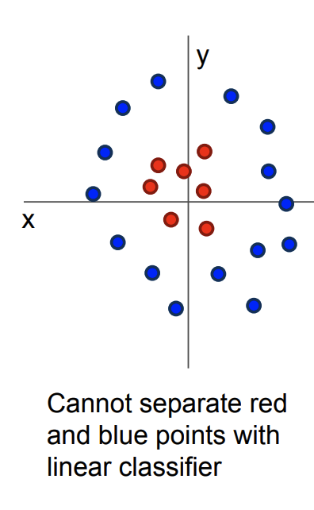
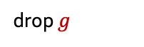
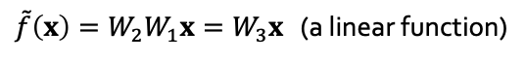
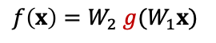
Why Add Non-linearity?
Without non-linearity, the overall model amounts to a linear model.
A linear function cannot approximate complex tasks.
Non-linearity adds capacity to the model to approximate any continuous function to arbitrary accuracy given sufficiently many hidden units.
See “universal approximation theorem”
$$f\left(x\right)=W_{2} g(W_{1}x)$$
$\tilde{f}\left(x\right)=W_{2}W_{1}x=W_{3}x$ (a linear function)
drop $g$
Notes:
Another question: Why do we need the nonlinearity function? Why can't we just get rid of it?
Without nonlinearity, the network is just a linear function, and we wouldn't get the power of nonlinearity to slice up space.
Nonlinearity allows for more complex representations, which are necessary for tasks that aren't linearly separable.
Merge:
Do neural networks have enough capacity to represent complex functions? This is a fundamental question about neural networks' true capability, heavily studied in mathematical literature. The broad literature is called the universal approximation theorem, a fundamental finding from the 80s or 90s. It states that any function can be approximated by a neural network with arbitrary error margin. This is important. Think of any function; there is a neural network that can describe it if given enough capacity.

Slide 30
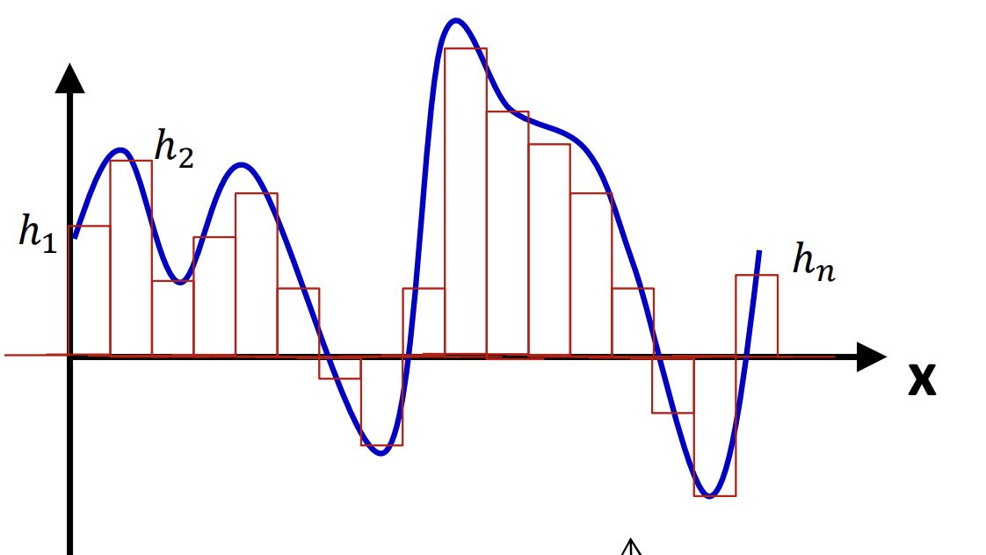
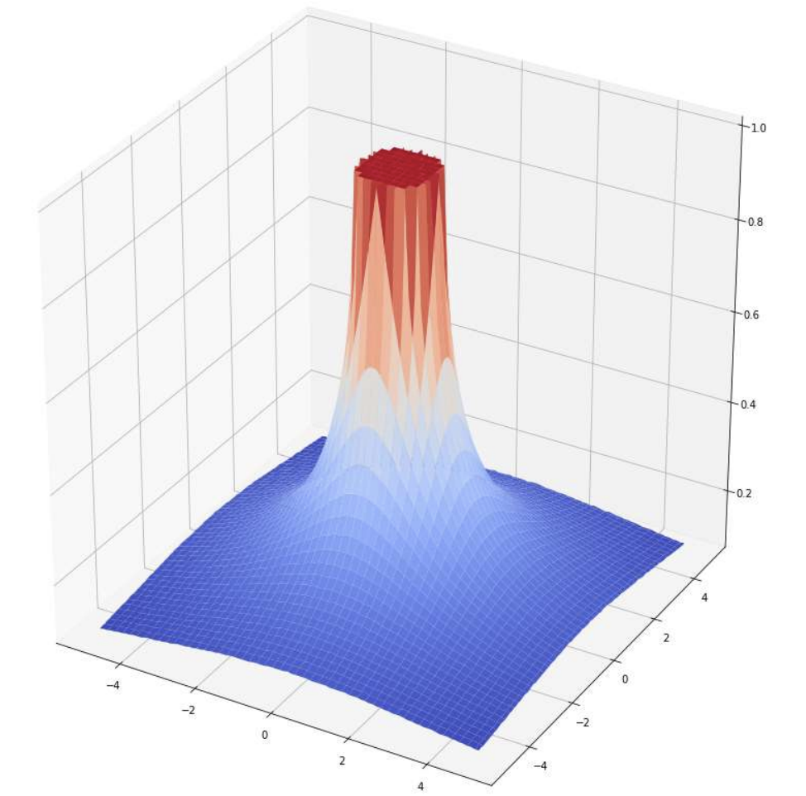
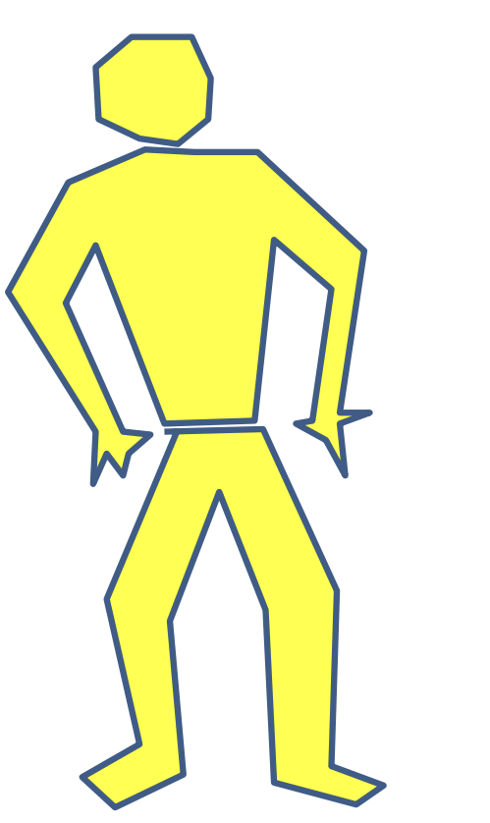
Universal Approximation
An MLP can represent any function, with enough expressivity.
Maiorov & Pinkus. Lower bounds for approximation by MLP neural networks, 1999.
Notes:
There are results in theoretical machine learning that show neural networks are universal approximators.
This means that any function you have in mind can be represented by a neural network with enough capacity.
This capacity could be nonlinearity, the size of the network, or other factors.
This result s called the Universal Approximation Theorem.

Slide 31
Quiz Time
What makes neural networks expressive functions?
Activations (non-linearities)
Depth (number of hidden layers)
Width (number of variables in each hidden layer)
All the above
Notes:
Quiz: What makes neural networks expressive functions? Is it their activations, depth, width, or all of the above?
All of the above. Activations, depth, and width all contribute to the expressiveness of neural networks.

Slide 32
Demo time!
Link: https://playground.tensorflow.org/
Notes:
Let's verify this with a demo. We have a simple example with clusters of lines.
Let's do a demo to see neural nets in action. This demo allows you to define hidden layers, increase depth, width, change activation functions, and problems. It's a cool demo to play with. We want to separate green circles from orange dots. What's the simplest neural network for this problem? Start simple, with one hidden layer. Do people agree one neuron is enough? Yes. Let's train it. It successfully separates the regions. Great, thank you.
Now, let's complicate the problem. It's not linearly separable. What's the simplest neural network for this? One hidden layer with two neurons. How many agree? Let's try it. We added another neuron, and now we can separate three spaces. One neuron separates one region, another separates another. If you restart training, you might get different results. Let's restart a few times. None solve the problem. What should we do? Add another neuron or layer. Let's add one more hidden layer with one neuron. Try it a few times. Maybe it's not enough. Let's add two neurons. Now we got it.
What changed with one additional layer? Depth creates more complex, soft edges. More layers allow for more nuanced curvature in the function space. Depth is important for representational capacity.
This demo is fun. Spend time with it to gain intuition. Let's try again. Restart training. Now it doesn't solve it. What happened? The optimization is highly nonlinear with many local optima. Some local optima aren't good enough. Sometimes you need patience.
Could we solve it with four neurons in one hidden layer? Let's try that. How many agree? Let's see. It does solve it, but the edge is bigger.

Slide 33
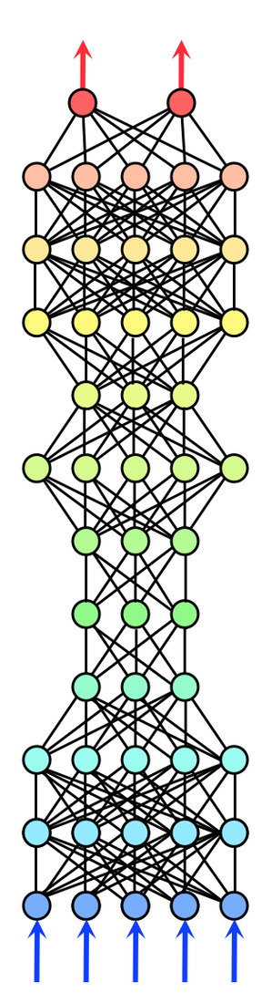
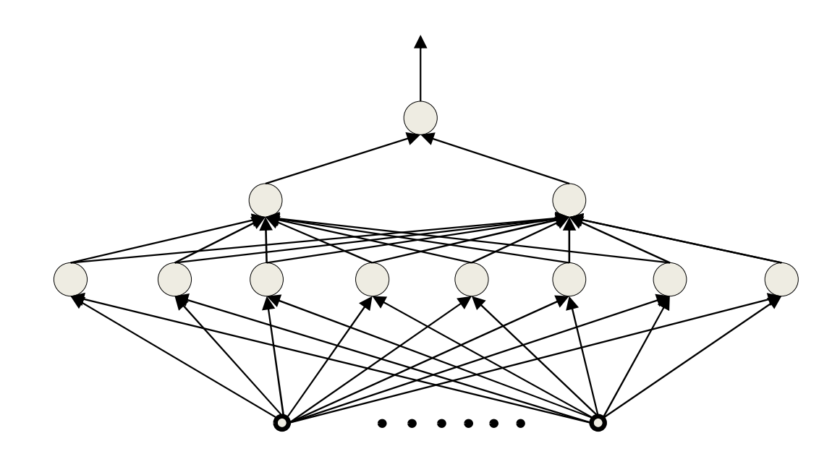
What is a good architecture? Depth vs. Width
Architectural parameters of a neural network affect its capacity to learn.
Deep vs. wide
Notes:
Alright, moving on.
Earlier we discussed that both width and depth would give your neural network more capacity.
How which one is more important? As in, if you need more capacity, should you prioritize depth or width?
This is surprisingly a non-trivial question to answer.
I can tell you that there are theoretical understandings regarding the impact of the depth of a neural network versus its width.
Merge:
Both width and depth give capacity. Should you increase depth or width? It's a complex question. The balance is non-trivial. There's mathematical literature on depth and width trade-offs, especially for Boolean functions or circuits. Shallow networks need more neurons than deep ones for the same function.

Slide 34
Depth vs Width on Boolean functions
An MLP is a universal Boolean function.
A shallow (single hidden layer) is a universal Boolean machine
But it may require an exponentially large number of units.
Deeper networks may require far fewer neurons than shallower networks to express the same function
Notes:
Specifically think about the space of Boolean functions, i.e., let's say you want to train a neural network to simulate a Boolean function.
A Boolean function is essentially a composition of ANDs and ORs on binary input.
Analysis on ”circuits” provide intuitions about the power of depth vs. width in neural networks.
Circuit: functions constructed with logical gates (AND, OR, XOR, …).
Now, if we want to train a neural network that approximates an arbitrary Boolean function, we know—there are proofs for this—that even a shallow neural network with just a few layers is a universal approximator of Boolean functions.
However, the width of this neural network might be extremely large. Deeper neural networks can also be universal approximators of Boolean functions, but they require far fewer neurons to achieve this.

Slide 35
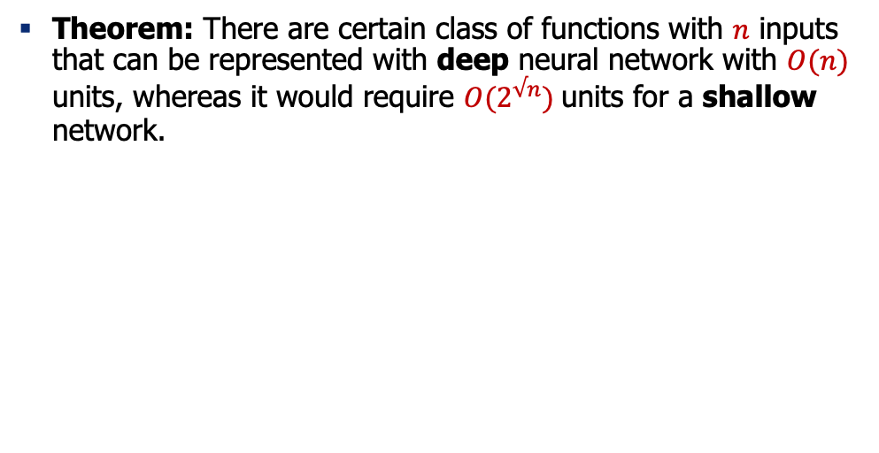
Depth vs Width on Boolean functions
Theorem: There are certain class of functions with $n$ inputs that can be represented with deep neural network with $O(n)$ units, whereas it would require $O(2^{√n})$units for a shallow network.
Hastad, Almost optimal lower bounds for small depth circuits, 1986.
Delalleau & Bengio. Shallow vs. deep sum-product networks, 2011.
Notes:
To make this point more formal, there's a theorem that states there are classes of functions with n inputs that can be represented with deep neural networks with a number of neurons that is in the same order as a linear function of your inputs. However, if you were to build a shallow network, the width of your architecture would be exponentially larger. That's the trade-off between depth and width. You might get a much more compact network by adding more depth, and that's where the term "deep learning" comes from. The idea is that if you make your architecture deep enough, it will give you really good expressive functions that can solve a variety of problems.

Slide 36
Summary
An MLP is a universal function
But can represent a given function only if
It is sufficiently wide
It is sufficiently deep
Depth can be traded off for (sometimes) exponential growth of the width of the network
Optimal width and depth depend on the complexity of the problem.
Next: A bit of history.
Notes:
To summarize, we talked about multi-layer perceptrons being universal functions that can represent many things. Whether they can represent many things or not depends on whether you give them enough capacity, meaning sufficient width, sufficient depth, and also nonlinearities that add more expressivity to your architecture. The optimal width and depth depend on the complexity of the problem; they're empirical questions that we need to answer based on our problem.
Next, we're going to talk about a bit of history behind neural networks, but before that, take a break, drink some water, and say hello to your neighbor.

Slide 37
Neural Nets: Origin and History
Notes:
Now, let's talk about the origin and history of neural networks.

Slide 38


Artificial Neurons: An Inspiration from Nature
A single node in your neural network
Accept information from multiple inputs
Transmit information to other neurons
A neuron’s function is inspired by its biological counterpart:
Apply some function on inputs signals
If output of function over threshold, neuron “fires”
Notes:
The first thing to mention is the inspiration from nature.
As you might have guessed or heard, neural networks are inspired by what's happening in nature, specifically in the human brain.
All the computational neurons we saw earlier, the linear function of input, and the activation function are really simulations of what's happening within your brain's neurons. Inside each neuron, you have these sensors, called dendrites in neuroscience, that collect signals from neighboring neurons.
These sensors collect information and bring the signal to the cell body inside your neuron.
The cell body is essentially the summation function that gathers the signals and decides how to propagate them further to other neurons.
The axon takes the signal from here, and if it's strong enough, it passes it on to the branches of your neuron.
This firing is equivalent to the nonlinearity function.
If your signal is strong enough, it results in firing or activation in the output of your artificial neuron.
------
From Wikipedia: At the majority of synapses, signals are sent from the axon of one neuron to a dendrite of another... All neurons are electrically excitable, maintaining voltage gradients across their membranes… If the voltage changes by a large enough amount, an all-or-none electrochemical pulse called an action potential is generated, which travels rapidly along the cell's axon, and activates synaptic connections with other cells when it arrives.
The dendrite of the neuron receives signals (information) from other neurons. The body of the neuron processes this information and if the accumulated signal is strong enough (exceeds a certain threshold), it sends it further through a long 'cable' called an axon. The axon terminus connects with the dendrites of other neurons through synapses. The strength of the connections between the neurons, i.e., the synapses, change as we learn - this process is known as synaptic plasticity.
The strength of the connections between the artificial neurons, similar to synapses in biological neurons, is represented by weights, which are adjusted during the training process, mirroring the process of synaptic plasticity in the human brain.
So in the analogy, dendrites are like the input values in an artificial neuron, the neuron body is like the processing stage (sum and non-linear function) in the artificial neuron, the axon is like the output of the artificial neuron, and synapses are analogous to the weights assigned to the inputs in artificial neural networks.

Slide 39
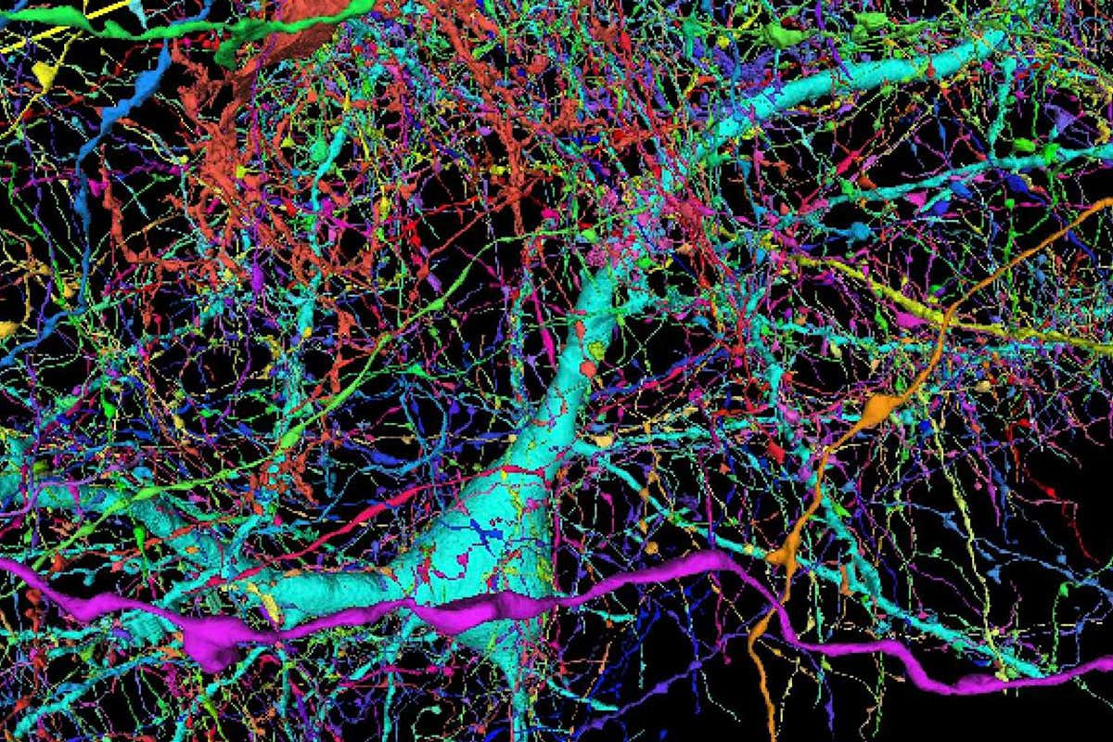
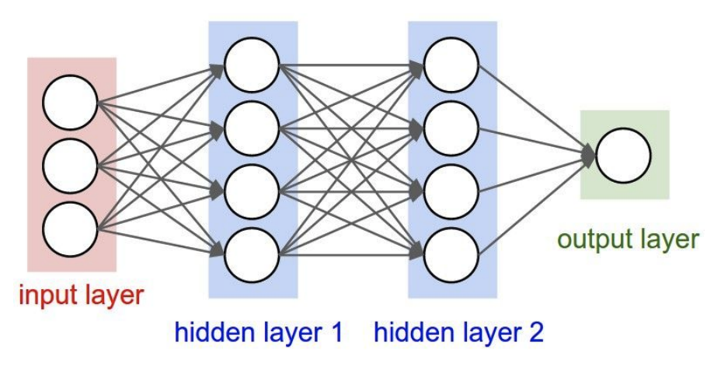
Artificial Neurons: Not Quite Analogous to Nature
Neurons in an artificial neural network:
organized based on a highly regular structure for computational efficiency
Biological neurons: complex connectivity
Source: Google Brain Map
Notes:
However, I want to caution you not to take these analogies too literally because the nature of the human brain is very different from artificial neurons.
The human brain is highly complex with dense connections, unlike the organized and sequential nature of artificial neurons.
They're quite different, like apples and oranges.
Maybe in the future, they'll get closer, but for now, we have this loose analogy between the two.
-----
Be careful with analogies:
Many different types
Dendrites can perform complex non-linear computations
Synapses are not a single weight but a complex nonlinear dynamical system
Abstracting a neuron by “firing rate” isn’t enough; temporal sequences of activations matter too (spiking neural networks)

Slide 40
Very Brief History of Neural Networks
Single-layer neural networks (1943-1969)
Symbolic AI & knowledge engineering (1970-1985)
Multi-layer NNs and symbolic learning (1985-1995)
Shallow statistical learning/probabilistic models (1995-2010)
Deep networks and self-supervised learning (2010-?)
Notes:
Now, let's go into the history and see how we got to this point.

Slide 41
Very Brief History of Neural Networks
Single-layer neural networks (1943-1969)
Symbolic AI & knowledge engineering (1970-1985)
Multi-layer NNs and symbolic learning (1985-1995)
Shallow statistical learning/probabilistic models (1995-2010)
Deep networks and self-supervised learning (2010-?)

Slide 42
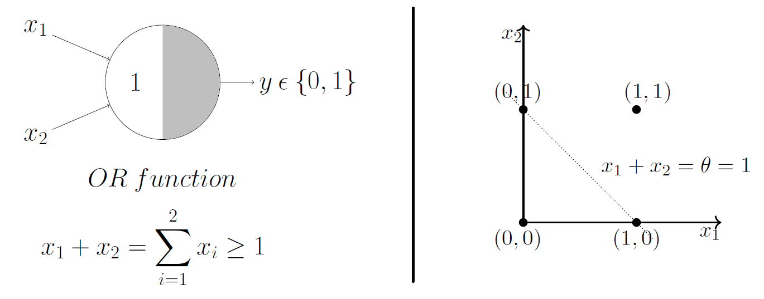
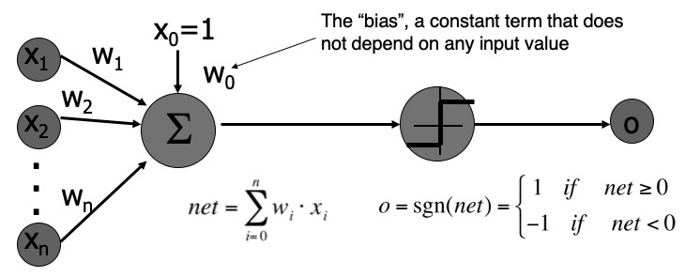
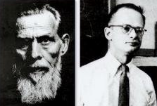
A Neuron as a Mathematical Model of Computation
McCulloch and Pitts (1943) showed how linear threshold units can be used to compute logical functions
An alternative model of computation (comparable to “Turing Machine”)
Notice the step function (threshold)! Early models didn’t need to be differentiable.
[A Logical Calculus of Ideas Immanent in Nervous Activity, McCulloch and Pitts 1943]
Notes:
We talked about history a bit in the first class, but I want to add more details.
The original works that inspired later developments were by McCulloch and Pitts, who created a simple formula for a single neuron called a linear threshold unit.
Notice that the nonlinearity function here is not differentiable;
Back then, they didn't care about differentiability; they just wanted to study its expressivity.
It was essentially an average function followed by a step function, and they showed it could express many logical operators like the OR function.
They thought of it as another framework for thinking about computation, similar to a Turing machine.
---
Walter Pitts, one of the scientists, didn't have much academic background.
He was interested in human cognition and lived in libraries, homeless for a while.
When he met McCulloch, they started working together, wrote a paper, and Pitts eventually got job offers.
It's an inspirational story, especially if you're having a difficult day.

Slide 43
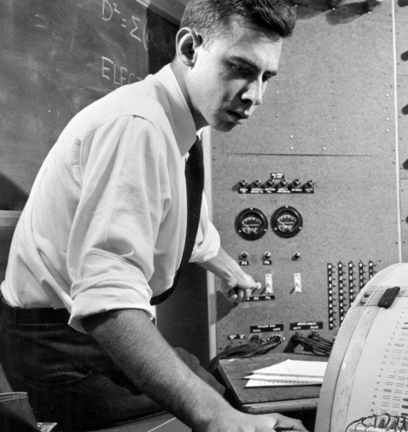
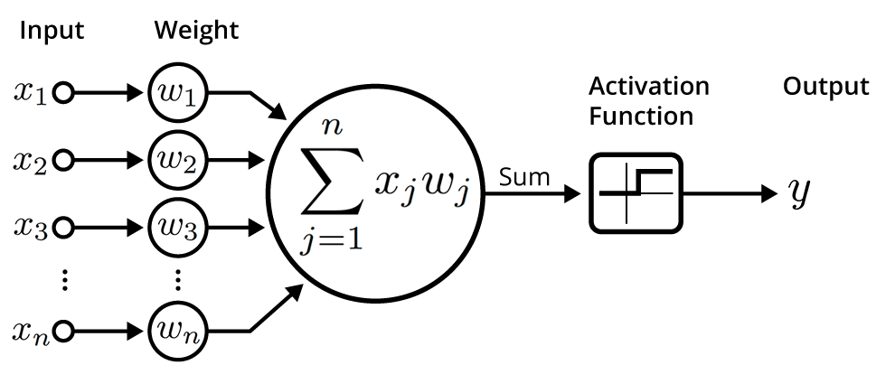
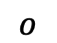
Perceptron Learning Rule — Imitating Nature’s Learning Process
Rosenblatt (1959) developed the Perceptron algorithm —
An iterative algorithm for learning the weights of a linear threshold unit.
A single neuron with a fixed input, it can incrementally change weights and learn to produce a fixed output using the Perceptron learning rule.
Update each weights by:
$$o$$
t: the target value
[The perceptron: a probabilistic model for information storage and organization in the brain, Rosenblatt 1959]
Notes:
Rosenblatt took their model, the linear threshold unit, and defined a learning framework for adjusting the weights of these inputs so that this simple framework could learn a function.
The learning rule Rosenblatt came up with was an update rule.
At every iteration, you take the existing weight corresponding to input xi, add a term, and get a new term for that weight.
This term is the difference between the target value and the current prediction, multiplied by a constant and the input value.
This learning rule is similar to gradient descent, although Rosenblatt developed it independently.

Slide 44
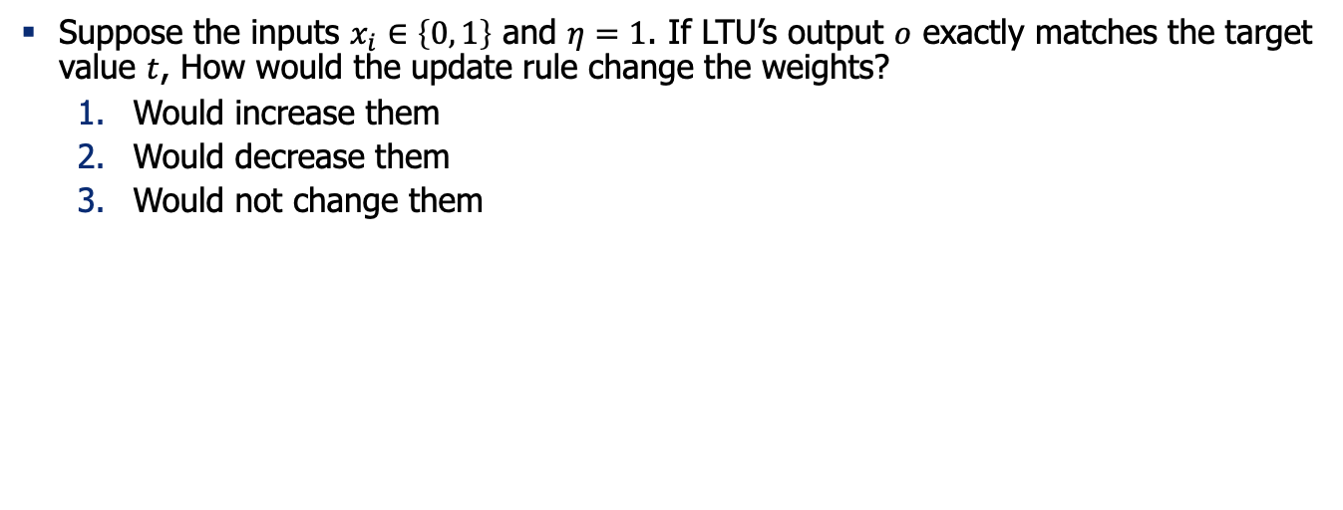
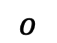
Quiz (1): Understanding Perceptron Update Rule
Suppose the inputs $x_{i}∈\left\{0, 1\right\}$ and $η=1$. If LTU’s output $o$ exactly matches the target value $t$, How would the update rule change the weights?
Would increase them
Would decrease them
Would not change them
$$o$$
Notes:
Let's test our understanding of this formula.
Suppose our neuron produces an output that matches the target value.
If we run this update rule, how will it change the weights?
It won't change because the output matches the target, making the update term zero.

Slide 45
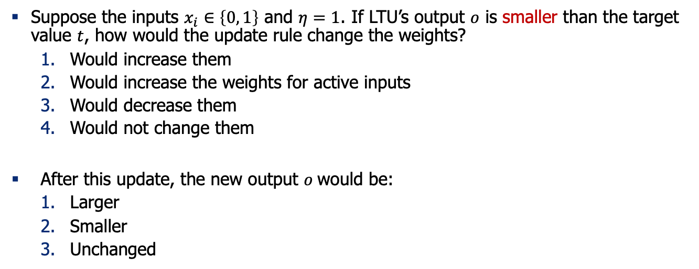
Quiz (2): Understanding Perceptron Update Rule
Suppose the inputs $x_{i}∈\left\{0, 1\right\}$ and $η=1$. If LTU’s output $o$ is smaller than the target value $t$, how would the update rule change the weights?
Would increase them
Would increase the weights for active inputs
Would decrease them
Would not change them
After this update, the new output $o$would be:
Larger
Smaller
Unchanged
$$o$$
Notes:
Now, if the output is smaller than the target,
Then the update rule will increase the weights, making the new output larger.

Slide 46
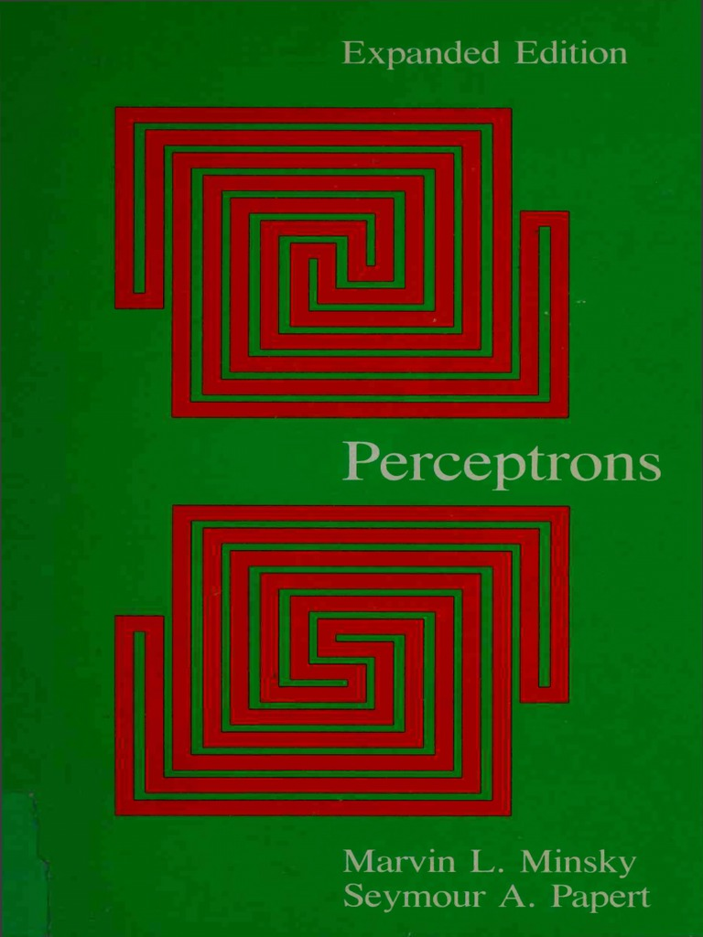
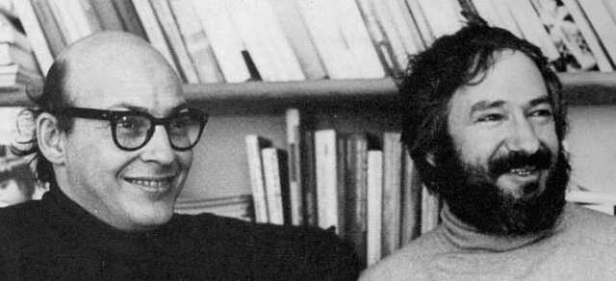
Perceptron: Demise
“Perceptrons” (1969) by Minsky and Papert illuminated few limitations of the perceptron.
It showed that:
Shallow (2-layer) networks are unable to learn or represent many classification functions (e.g. XOR)
Only the linearly separable functions are learnable.
Also, there was an understanding that deeper networks were infeasible to train.
Result: research on NNs dissipated during the 70’s and early 80’s!
[slide: Ray Mooney]
Notes:
Rosenblatt's update rule for the perceptron generated excitement because it provided a computational model of human neurons and a formula for training them.
However, Minsky and Papert wrote a book highlighting the limitations of perceptrons, such as their inability to learn certain functions with shallow architectures.
This led to disappointment in neural networks, contributing to an "AI winter" where interest in neural networks waned for about 20 years.

Slide 47
Very Brief History of Neural Networks
Single-layer neural networks (1943-1969)
Symbolic AI & knowledge engineering (1970-1985)
Multi-layer NNs and symbolic learning (1985-1995)
Shallow statistical learning/probabilistic models (1995-2010)
Deep networks and self-supervised learning (2010-?)

Slide 48
Very Brief History of Neural Networks
Single-layer neural networks (1943-1969)
Symbolic AI & knowledge engineering (1970-1985)
Multi-layer NNs and symbolic learning (1985-1995)
Shallow statistical learning/probabilistic models (1995-2010)
Deep networks and self-supervised learning (2010-?)
Notes:
In the next stage, people shifted to different AI approaches.

Slide 49
Neural Networks Resurgence (1986)
Interest in NNs revived in the mid 1980’s due to the rise of “connectionism.”
Backpropagation algorithm was [re-]introduced for training three-layer NN’s.
Generalized the iterative “hill climbing” method to approximate networks with multiple layers, but no convergence guarantees.
what was possible
to train in 1970’s
what became possible to train via BP in 1980’s
[Learning representations by back-propagating errors, Rumelhart, Hinton & Williams 1986; for a broader context, see: http://people.idsia.ch/~juergen/who-invented-backpropagation.html]
Notes:
The third stage was sparked by findings about more efficient algorithms for training deeper neural networks, like backpropagation.
This algorithm, a sophisticated form of gradient descent, made training deeper architectures more feasible.

Slide 50
Second NN Demise (1995-2010)
Generic backpropagation did not generalize that well to training deeper networks.
Overfitting / underfitting remained an issue.
Computers were still quite slow
Little theoretical justification for underlying methods.
Machine learning research moved to graphical/probabilistic models and kernel methods.
[slide: Ray Mooney]
Notes:
However, challenges like computational expense and overfitting persisted, leading to another decline in neural network use.

Slide 51
Very Brief History of Neural Networks
Single-layer neural networks (1943-1969)
Symbolic AI & knowledge engineering (1970-1985)
Multi-layer NNs and symbolic learning (1985-1995)
Shallow statistical learning/probabilistic models (1995-2010)
Deep networks and self-supervised learning (2010-?)
Notes:
Machine learning research moved to graphical/probabilistic models and kernel methods.

Slide 52
Very Brief History of Neural Networks
Single-layer neural networks (1943-1969)
Symbolic AI & knowledge engineering (1970-1985)
Multi-layer NNs and symbolic learning (1985-1995)
Shallow statistical learning/probabilistic models (1995-2010)
Deep networks and self-supervised learning (2010-?)
Notes:
Machine learning research moved to graphical/probabilistic models and kernel methods.

Slide 53
Very Brief History of Neural Networks
Single-layer neural networks (1943-1969)
Symbolic AI & knowledge engineering (1970-1985)
Multi-layer NNs and symbolic learning (1985-1995)
Shallow statistical learning/probabilistic models (1995-2010)
Deep networks and self-supervised learning (2010-?)

Slide 54
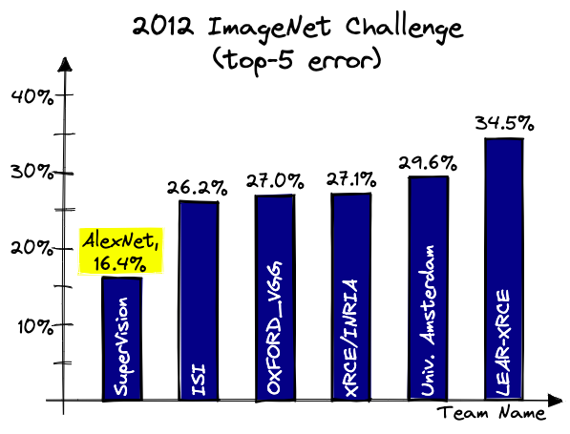

Deep Learning Revolution (2010…)
Various successes with training deep neural works.
Convolutional neural nets (CNNs) for vision — 2012 AlexNet showed 16% error reduction on ImageNet benchmark.
Rise of deep reinforcement learning for games—AlphaGo beat human players.
Notes:
Eventually, with faster computers and more data, interest in neural networks resurged.
A key moment was the introduction of AlexNet, a neural network that significantly reduced error rates in image classification competitions.
This success, along with others like AlphaGo, marked the third era of neural networks.

Slide 55
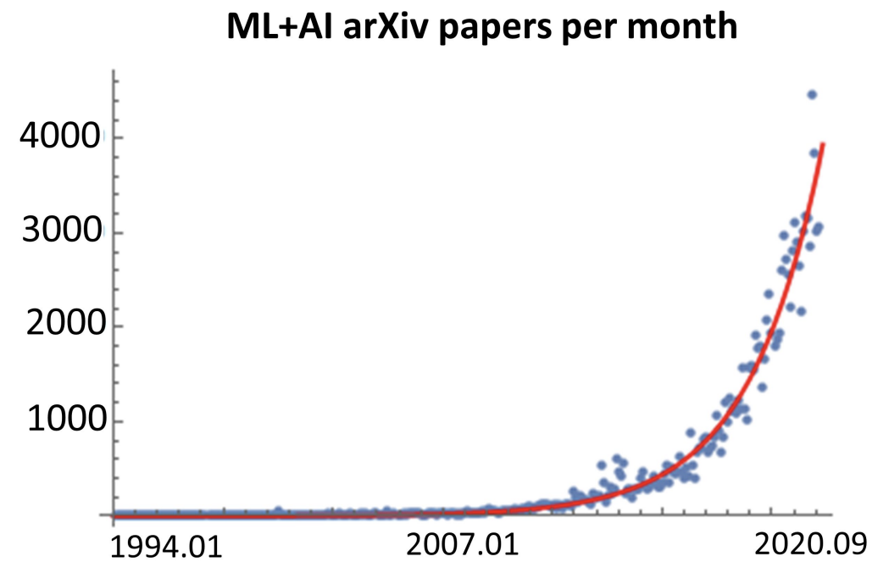
Deep Learning Revolution (2010…)
Various successes with training deep neural works.
Convolutional neural nets (CNNs) for vision — 2012 AlexNet showed 16% error reduction on ImageNet benchmark.
Rise of deep reinforcement learning for games—AlphaGo beat human players.
arXiv papers per month
Figure credit:
https://twitter.com/MarioKrenn6240/status/1314622995139264517
Notes:
The number of machine learning publications has since increased rapidly,

Slide 56



Deep Learning Revolution (2010…)
The success continued enabled by 3 forces:
Availability of massive [unlabeled] data — the data on Internet.
Faster computing technologies — specialized hardware (e.g., GPUs)
Algorithmic innovations — architectures, optimization, etc.
Notes:
driven by algorithmic improvements, better computational architectures, and more data.

Slide 57
Very Brief History of Neural Networks
Single-layer neural networks (1943-1969)
Symbolic AI & knowledge engineering (1970-1985)
Multi-layer NNs and symbolic learning (1985-1995)
Shallow statistical learning/probabilistic models (1995-2010)
Deep networks and self-supervised learning (2010-?)

Slide 58

https://en.wikipedia.org/wiki/Big_Bounce
Notes:
The history of AI very much resembles a model of universe in cosmology, in which it goes through periods of expansion and contraction
The first one ….
The second one …
Now it seems like we are at a major expansion
If history is any guide, we will inevitably go though another round of contraction in future, but the technology will come out stronger and better at the end of it.

Slide 59

How it started How it’s going
[slide: Ray Mooney]
Notes:
We started with McCulloch and Pitts' model and have now reached deep architectures with many parameters, managed by engineers working with large GPU clusters.

Slide 60
Summary
Neural networks have been long in the making since 1950s.
It’s a remarkable journey of science with many ups and downs.
Next: How do you train NNs? We will start with some algebra refreshers.
Notes:
To summarize, neural networks have been a long time in the making,
with a remarkable journey of ups and downs.
Next, we'll focus on how to train neural networks, starting with an algebra refresher.

Slide 61
Background for Training NNs The Refreshers🍹
Notes:
Before we dive into training neural networks, we'll review some fundamentals, focusing on the setup of the statistical learning problem.

Slide 62

Machine Learning Problems
Training data: Given a set of inputs and output labels:
Inputs: $X=\left(x_{1},…,x_{n}\right)$
Outputs: $Y=\left(y_{1},…,y_{n}\right)$
Goal: Find a function $f(x;θ)$ with parameters $θ$ that maps inputs in $X$ to output to $Y$
Empirical risk: measure the quality of the predictions with a loss function:
$$J\left(θ\right)=\frac{1}{n}\sum_{i=1}^{n}{ℓ(f\left(x_{i};θ\right), y_{i})}$$
Notes:
The setup for statistical learning involves training data with inputs and corresponding output labels. The goal is to train a function, represented by parameters, to approximate the mapping from inputs to outputs. You define a loss function over your training data to quantify the gap between predictions and gold labels, aiming to minimize this loss.
Merge:
The setup involves having a set of training data, which are your inputs, labeled as X1 to Xn. Each input has corresponding output labels, Y. The goal is to train a function, represented by parameters Theta, to approximate the mapping from X to Y accurately. To achieve this, you define a loss function over your training data. This function makes predictions based on inputs, and you want it to be as close as possible to the actual labels. The loss function quantifies the difference between predictions and actual labels, and you aim to minimize this loss across the training set.

Slide 63


A Special Case: Linear Regression
Training data: Given a set of inputs and output labels:
Inputs: $X=\left(x_{1},…,x_{n}\right)$
Outputs: $Y=\left(y_{1},…,y_{n}\right)$
Goal: Find a linear function $f\left(x;θ\right)=θ.x$ that is best predictive of observations
Empirical risk: measure the quality of the predictions with a loss function:
$$J\left(θ\right)=\frac{1}{n}\sum_{i=1}^{n}{ℓ(θ.x_{i}, y_{i})}$$
What are good choices for loss function?
Notes:
An analogy is linear regression, where you have noisy samples from a line function. The loss function quantifies the distance between the predicted and actual outputs. The choice of loss function is important. A reasonable loss function should have a higher value when predictions are far from the target. Common loss functions include squared loss and absolute loss, but our focus is on cross-entropy loss.

Slide 64

Quiz: Loss functions
Remember the objective function of our learning problem:
$$J\left(θ\right)=\frac{1}{n}\sum_{i=1}^{n}{ℓ(f\left(x_{i};θ\right), y_{i})}$$
Which of the followings is a more reasonable loss function $ℓ\left(z, w\right)$?
If $z$and $w$are far apart, the loss value should be higher
If $z$and $w$are far apart, the loss value should be lower
Neither
Notes:
What kind of function makes a good loss function? Here's a question: if Z and W are far apart, should the loss value be higher or lower? The answer is that the loss value should be higher when Z and W are far apart. The loss function should quantify how poor your predictions are. The worse the predictions, the higher the loss value, indicating the amount you're losing.

Slide 65



Loss Functions
The choice of loss function depends on the problem
$$ℓ\left(y, \hat{y}\right)={\left(y−\hat{y}\right)}^{2}$$
$$ℓ\left(y, \hat{y}\right)=|y−\hat{y}|$$
Notes:
There are various loss functions you might have encountered in machine learning courses. One common loss function is the squared loss, which is the squared distance between two predictions. Another option is the absolute distance between two values. These are common in statistical learning ....

Slide 66



Quiz: MSE vs. MAE loss
MSE: $ℓ\left(y, \hat{y}\right)={\left(y−\hat{y}\right)}^{2}$
Remember MSE and MAE loss:
Which visualization corresponds to which loss?
Which loss is more sensitive to outlier data (noisy outputs)?
Which loss is more difficult to compute gradients for?
MAE: $ℓ\left(y, \hat{y}\right)=|y−\hat{y}|$

Slide 67
Loss Functions
The choice of loss function depends on the problem
$$ℓ\left(y, \hat{y}\right)={\left(y−\hat{y}\right)}^{2}$$
$$ℓ\left(y, \hat{y}\right)=|y−\hat{y}|$$
Notes:
Instead, let's focus on a loss function called cross-entropy. Cross-entropy is defined by a specific formula. Y is the goal label, and Y hat is the prediction. The function is computed over the dimensions of your prediction.

Slide 68



Loss Functions: Cross-Entropy
$$ℓ\left(y, \hat{y}\right)=−\sum_{j}^{n}{y_{j}log⁡(\hat{y_{j}})}$$
A binary classification example: Without loss of generality:
Gold labels: $y=[1, 0]$ (i.e., first class is correct)
Predictions: $\hat{y}=\left[p, 1−p\right]$
CE loss: $ℓ\left(y, \hat{y}\right)=−1×\log{p}−0×\log\left(1−p\right)=−\log{p}$
Summation over the dimensions of $y$
Notes:
Cross-entropy loss is computed over the dimensions of your prediction. For binary prediction, the goal label is either one class or the other. The model makes a probabilistic prediction, and cross-entropy quantifies the loss based on the accuracy of this prediction. If the model is accurate, the loss is zero; if inaccurate, the loss is high.
For binary prediction, your goal label can be 1 or 0, representing two classes. If the goal label is the first class, your model predicts a probability P for the first class and 1-P for the second class. The sum of these probabilities should equal one. Cross-entropy is a summation over all dimensions, and there's a typo in the formula I showed earlier. It should be corrected to reflect that the value should be one in certain dimensions.

Slide 69

Quiz: CE for Binary Classification
$$ℓ\left(y, \hat{y}\right)=−\sum_{j}^{n}{y_{j}log⁡(\hat{y_{j}})}$$
A binary classification example: Without loss of generality:
Gold labels: $y=[1, 0]$ (i.e., first class is correct)
Predictions: $\hat{y}=\left[p, 1−p\right]$
CE loss: $ℓ\left(y, \hat{y}\right)=−1×\log{p}−0×\log\left(1−p\right)=−\log{p}$
Question 1: Why the negative sign?
Question 2: If the model prediction is miraculously accurate ($p=1$), what is CE loss?
Question 3: If the model prediction is embarrassingly off ($p=0$), what is the CE loss?
Summation over the dimensions of $y$

Slide 70





Cross-Entropy Over Next-Word Distribution
$$\hat{y}$$
$$y$$
$$ℓ\left(y, \hat{y}\right)=−\sum_{j}^{n}{y_{j}log⁡(\hat{y_{j}})}$$
Suppose for a fixed $j$, $y_{j}=1$.
Question: Then CE is the probability is? ….
It is the probability that our language model assigns to the $j$th term.
Prob
$$\left[\begin{aligned}0 \\ 1 \\ 0 \\ 0 \\ 0 \\ \\ \\ \end{aligned}\right]$$
mat
table
bed
desk
chair
Language Model
…
Summation over the dimensions of $y$
…

Slide 71

Machine Learning Problems
Training data: Given a set of inputs and output labels:
Inputs: $X=\left(x_{1},…,x_{n}\right)$
Outputs: $Y=\left(y_{1},…,y_{n}\right)$
Goal: Find a function $f(x;θ)$ with parameters $θ$ that maps inputs in $X$ to output to $Y$
Empirical risk: measure the quality of the predictions with a loss function:
$$J\left(θ\right)=\frac{1}{n}\sum_{i=1}^{n}{ℓ(f\left(x_{i};θ\right), y_{i})}$$
Machine learning as optimization:
$\underset{θ}{argmin}{J\left(θ\right)}$
How do you solve this optimization?
Notes:
The setup was that we were given some training data and someone also provided us with a function class, which could be a network. You want to define it, and you have to define an objective function based on an L function of inputs and outputs. The goal is to minimize this. Last time, we defined a bunch of loss functions, so we got a sense of how these loss functions would look. We talked about the L function, so we are going to move past the discussion of the L function today.
The discussion now is, now that we have defined this function, how can we actually go about optimizing it? That's the question.

Slide 72


Gradient Descent
We have a cost function $J\left(θ\right)$we want to minimize
We can use Gradient Descent algorithm!
Idea: for current value of $θ$, calculate gradient of $J\left(θ\right)$, then take small step in direction of negative gradient. Repeat.
Note: Our objectives may not be convex like this. But life turns out to be okay!
Notes:
To do that, many of you might be familiar with this algorithm known as gradient descent. The way gradient descent works is, after defining an objective, a minimization objective, we run an iterative algorithm. At each step of the iteration, we take one step in the direction of the minimum of this objective. This is the high-level idea, and I'm simplifying things a bit by showing you a convex objective function. In reality, the objective functions you optimize are highly nonlinear, so the optimization path is much more complicated.

Slide 73


Gradient Descent (1): Intuition
Imagine you’re blindfolded
Need to walk down a hill
You can use your hands to find the directions that may be downhill
[slide: Andrej Karpathy]
Notes:
One thing I find very helpful for my own imagination is to think of gradient descent as if you're on top of a mountain, like Mount Everest, and you want to go down, but you're blindfolded. You don't see which direction to go. Essentially, you're blindfolded and want to go down. How would you do that? I think you would use your hands to sense if the slope feels steeper in one direction or another. You're acting very locally, just feeling your way down the mountain. That's essentially how gradient descent works too. The information about the direction of maximum decrease is very local to where you currently are, and you don't have a bird's-eye view of whether it's the right direction or if there's a hill or valley in sight. It's all local information, so you're blindfolded.

Slide 74



Gradient Descent (2): Intuition
$$\frac{∂J}{∂θ_{j}}=\lim_{h→0}{\frac{J\left(θ_{j}+h\right)−J(θ_{j})}{h}}$$
In 1-dimension, the derivative of a function:
Gradient is the vector of derivatives: $∇_{θ}J=\left[\frac{∂J}{∂θ_{1}}, …,\frac{∂J}{∂θ_{n}}\right]$
Gradient descent involves iterative steps in in direction of negative gradient.
Question: Why step in direction of negative gradient?
Gradient quantifies how rapidly the function $L(θ)$ varies when we change the argument $θ_{j}$ by a tiny amount.
Notes:
One question you might have is, why gradients? The answer is that gradients quantify, at each point in your function, the direction of maximum decrease. If you're at a point where your function is flat, the gradient will be zero. But the more slope you have, the larger the gradients will be. Not only are the values of the gradients informative about the amount of decrease, but the direction of the gradients also shows the direction you should go to decrease your function maximally. Feel free to interrupt me if you have any questions.

Slide 75





Gradient Descent (3)
Iteratively subtract the gradient with respect to the model parameters ($θ$)
In PyTorch:
$α$ = Step size or learning rate
$$θ^{new}←θ^{old}−α ∇_{θ}J(θ^{old})$$
We’re moving in a direction opposite to the gradient of the loss $J(θ)$
I.e., we’re moving towards smaller loss $J(θ)$
Notes:
As soon as we start computing the gradients, as we said, gradients also give us the direction of maximum reductions in our L function. All we need to do is start from some initial choices of parameters and iteratively update our parameters in a way that minimizes our gradients with some weight. This weight is usually called a step size or a learning rate. It determines how fast you are going in the direction of the gradients. For example, going down the mountain, you might choose to take larger steps or smaller ones. It's a trade-off. By going larger, you might go faster downhill, but if you take too large of a step, you might fall. You have to be careful because there might be things you don't see when you're feeling your way locally. Taking too large of a step can be unknown and risky.
The idea of implementing this is simple. If you want to implement it in Python, it's essentially a few lines of code. It's a simple idea but very powerful.

Slide 76


Gradient Descent (4)
Update equation (in matrix notation):
[demo credit: ICMS YouTube channel]
Notes:
I want to give you as much intuition as possible. Here's a visualization of gradient descent in some 3D space. The simulation shows a terrain, like your objective function, which is non-convex. You have two balls representing the current state of your parameters, and we let these balls go downhill based on the physics of this valley. They are essentially simulating gradient descent with two different initializations. Let's watch this. You see here, one ball starts here and gets stuck in a local minimum, but the other ball starts elsewhere and ends up in a deeper local minimum. This connects to a demo we saw last time. I ran it once, and it got stuck, but after restarting, it worked. That's the power of random restarts in gradient descent.

Slide 77


Gradient Descent: Setting the Step Size
What is a good value for step size $α$?
If $α=$ too small, it may be too slow
If $α=$ too large, it may oscillate
It may take trial-and-errors to find the sweet spot.
Another trick is to define a “schedule” for gradually reducing the learning rate starting from a large number.
[figure from: https://www.jeremyjordan.me/nn-learning-rate/]
Notes:
Going back to the issue of step sizes, I want to give you some intuition about them. As we said, the step size can be tricky to set. If you're taking too small of a step size, it might be unnecessarily small, making your convergence very slow. On the flip side, if you're taking too large of a step size, you might skip the minimum and end up on the other side of the mountain. If you take an even larger step size, you might escape the current valley and go somewhere completely unknown. It can be dangerous to take too large of a step. There's always a sweet spot; you don't want a step size that's too small or too large. This is something we need to tweak and fine-tune with repeated experimentation.

Slide 78






A Typical Learning and Evaluation Protocol
Each choice of parameters in neural networks correspond to another function.
Model Hypothesis Class
$$ℱ=\left\{f_{1},f_{2},f_{3},…\right\}$$
Training data
$$D_{train}=\left\{\left(x_{1},y_{1}\right), …\right\}$$
Overall training: picking the best function:$f^{∗}$
Training is to pick the function given the observed data.
Held-out validation data
$$D_{val}=\left\{\left(x_{1},y_{1}\right), …\right\}$$
Testing is t predict the quality of the best selected function
Testing data
$$D_{test}=\left\{\left(x_{1},y_{1}\right), …\right\}$$
Evaluation on test set:
$${E_{\left(x, y\right) \sim D_{test}}\left[\left(ℓ(f\left(x\right),y\right)\right]}^{}$$
Notes:
This is more like a big picture of how the statistical learning pipeline should look.
The starting point in every statistical learning experiment is defining your hypothesis class. The hypothesis class is essentially the class of functions you want to experiment on. If you want to train linear classifiers, this will be the space of all potential linear classifiers. If you want to transform your data, this will be the space of all transformations. This defines the architectural choices. Then, you come up with your training data, which you keep separate from your validation data. You keep them separate because you don't want your model to cheat or be evaluated on data it has been trained on. You train your model on the training data, but while training, you also monitor its progress on unseen validation data to ensure it can generalize to unseen data. After selecting your best parameters and model, you evaluate it on a final test set, which is also separate from your validation and training data. This is the ultimate number you report to your boss or whoever is asking you to train the model. This is the overall pipeline of statistical learning.

Slide 79
Summary Thus Far
A statistical learning problem can be formulated as an optimization problem.
The objective of this optimization consists of:
Learning data (input/outputs)
Predictive model architecture (encoding how an input gets mapped to an output)
Loss function (quantifying quality of predictions)
Soon, we will use see how to use Neural Nets as the predictive model.
Notes:
To summarize, we talked about the overall pipeline of statistical learning. I mentioned how we formulate this as an optimization problem. To define this problem, there are three things we need: training data, the architecture of our predictive model, and the L function that quantifies our success. With these three, we can define an objective function to optimize. The next section we'll discuss, after one more round of refreshers, is when the choice of these architectures is neural networks. We'll do some algebra refreshers, so we're going to talk about derivatives. Just a warning, we're going to do some math reminders. If you follow this, it will be helpful when we talk about training neural networks.

Slide 80
Algebra Refresher
(Needed for Backpropagation)
Notes:
Now, some reminders. Let's see if you remember your basic math.

Slide 81




Derivatives
First let’s get the notation right:
The arrow shows functional dependence of $z$on $y$, i.e. given $y$, we can calculate$z$.
For example:$z(y) = 2y^{2}$
The derivative of $z$, with respect to $y$: $\frac{∂z}{∂y}$
$$z$$
$$\frac{∂z}{∂y}$$
$$y$$
Notes:
Let's establish the notation here. When I show two or three variables, like these circles, the arrow shows the direction of dependence.
In this case, Z depends on Y, and you need Y to compute Z. In other words, Z can be computed as a function of Y.
For example, Z might be defined as 2 * Y^2. Given Y, you can compute it Z.
Now let’s think about the derivative of Z with respect to. Y.

Slide 82



Quiz time!
If $z(x, y)={y^{4}x}^{5}$what is the following derivative $\frac{∂z}{∂y}$ ?
$\frac{∂z}{∂y}=4y^{3}x^{5}$
$\frac{∂z}{∂y}={5y}^{4}x^{4}$
$\frac{∂z}{∂y}={20y}^{3}x^{4}$
None of the above
$$z$$
$$y x$$
Notes:
Here is a quick test for ensuring that you’re follow along.
Z is a function of Y and X. and it is defined as Y^4 * X^5.
Given this information, what do you think is the derivative of Z with respect to one variable?
Feel free to pause this video and identify the right answer.
Hopefully you found the right answer. Great!

Slide 83






Gradient
$$f$$
Given a function with 1 output and $n$ inputs
Its gradient is a vector of partial derivatives with respect to each input
$$x_{1} x_{2} … x_{n}$$
$$f\left(x\right)=f\left(x_{1},x_{2}, …,x_{n}\right)∈ℝ$$
$∇f\left(x\right)=\left[\begin{aligned}\frac{∂f}{∂x_{1}} \\ \frac{∂f}{∂x_{2}} \\ ⋮ \\ \frac{∂f}{∂x_{n}}\end{aligned}\right]$ $∈ℝ^{n}$
(always assume vectors are column vectors, i.e., they’re in $ℝ^{n×1}$)
Notes:
The next topic covers the extension of derivatives into gradients.
You've likely encountered in your studies that derivatives can be expanded from one-dimensional information to multiple dimensions using gradients.
When dealing with a scalar function that depends on several variables, X1 to Xn, all the derivatives with respect to these variables can be represented in a concise format known as a gradient.
A gradient is simply a compact way to represent derivatives across multiple dimensions.

Slide 84

Quiz time!
If $z(x,y)={y^{4}x}^{5}$what is the following gradient $∇z$?
$∇z(x,y)=4y^{3}x^{5}$
$∇z(x,y)=({5y}^{4}x^{4},{20y}^{3}x^{4}$)
$∇z(x,y)=({5y}^{4}x^{4},{4y}^{3}x^{5}\text{)}$
None of the above
$$z$$
$$y x$$
Notes:
Here's another quick quiz question to ensure you're keeping up.
Referring to the same function from the previous example, the question is: What is the gradient of Z with respect to X and Y?

Slide 85




Jacobian Matrix: Generalization of the Gradient
$$f_{1} {… f}_{m}$$
Given a function with m outputs and n inputs
It’s Jacobian is an m x n matrix of partial derivatives: ${\left(J_{f}\left(x\right)\right)}_{ij}=\frac{∂f_{i}}{∂x_{j}}$
$$x_{1} x_{2} … x_{n}$$
$$f\left(x\right)=\left[f_{1}\left(x_{1},x_{2}, …,x_{n}\right), …,f_{m}\left(x_{1},x_{2}, …,x_{n}\right)\right]∈ℝ^{m}$$
$$J_{f}\left(x\right)=\left[\begin{matrix}\frac{∂f_{1}}{∂x_{1}} & ⋯ & \frac{∂f_{1}}{∂x_{n}} \\ ⋮ & ⋱ & ⋮ \\ \frac{∂f_{m}}{∂x_{1}} & ⋯ & \frac{∂f_{m}}{∂x_{n}}\end{matrix}\right]∈ℝ^{m×n}$$
Notes:
Now, let's move beyond gradients.
Gradients are vectors that provide a compact representation of derivatives in one dimension.
However, when dealing with a more generalized version where the function's output is not a single scalar but a multi-dimensional list (a function of a matrix), we use a different concept called the Jacobian.
In this scenario, the function's output is no longer a scalar; it spans multiple dimensions, outputting to R^m.
This means you have a vector of M scalar functions, each depending on N variables.
To represent derivatives compactly in this context, we use the Jacobian, which extends the concept of gradients.
Each element of the Jacobian is the derivative of function f with respect to input x.
In matrix form, the first row represents the gradient of the first function with respect to all variables, and the last row represents the gradient of the last function with respect to all variables.
We'll build on this concept in a bit, so it's important to become comfortable with it.

Slide 86


Quiz: Jacobian’s special case (1)
Remember Jacobians:
When m=1 (scalar-valued function), Jacobian reduces to …?
$$f\left(x\right)=\left[f_{1}\left(x_{1},x_{2}, …,x_{n}\right), …,f_{m}\left(x_{1},x_{2}, …,x_{n}\right)\right]∈ℝ^{m}$$
$J_{f}\left(x\right)=\left[\begin{matrix}\frac{∂f_{1}}{∂x_{1}} & ⋯ & \frac{∂f_{1}}{∂x_{n}} \\ ⋮ & ⋱ & ⋮ \\ \frac{∂f_{m}}{∂x_{1}} & ⋯ & \frac{∂f_{m}}{∂x_{n}}\end{matrix}\right]∈ℝ^{m×n}$ or ${\left(J_{f}\left(x\right)\right)}_{ij}=\frac{∂f_{i}}{∂x_{j}}$
$∇^{T}f\left(x\right)$ (gradient transpose)
Notes:
Let's assess your understanding of Jacobians. We define the Jacobian in this way: if m equals 1, meaning there is only one function, what does the Jacobian simplify to?
It becomes a single gradient. Essentially, the Jacobian turns into a row vector containing the derivatives of that function with respect to all the variables.
I want to clarify that I'm using a notational convention commonly accepted in linear algebra, where a vector is often considered a column matrix.
Earlier, when I defined the gradient, it was as a column matrix, so the answer should have been the gradient transpose, since the gradient was defined as a column matrix, and you have this transpose here.

Slide 87

Quiz: Jacobian’s special case (2)
Remember Jacobians:
When m=n=1 (single-variable function), Jacobian reduces to …?
$$f\left(x\right)=\left[f_{1}\left(x_{1},x_{2}, …,x_{n}\right), …,f_{m}\left(x_{1},x_{2}, …,x_{n}\right)\right]∈ℝ^{m}$$
$J_{f}\left(x\right)=\left[\begin{matrix}\frac{∂f_{1}}{∂x_{1}} & ⋯ & \frac{∂f_{1}}{∂x_{n}} \\ ⋮ & ⋱ & ⋮ \\ \frac{∂f_{m}}{∂x_{1}} & ⋯ & \frac{∂f_{m}}{∂x_{n}}\end{matrix}\right]∈ℝ^{m×n}$ or ${\left(J_{f}\left(x\right)\right)}_{ij}=\frac{∂f_{i}}{∂x_{j}}$
the derivative of $f$
Notes:
Next question: if m equals 1 and n equals 1, what does the Jacobian reduce to?
it reduces to the function with only x, which is the derivative.
the derivative of f with respect to the only variable.

Slide 88


Jacobian for Matrix Inputs
Given a function with $m$ outputs and $n×p$ inputs
Jacobian is a $m×n×p$ tensor (i.e., matrix of matrices) of partial derivatives:
$${\left(J_{f}\left(X\right)\right)}_{ijk}=\frac{∂f_{i}}{∂x_{jk}}$$
The dimension of the Jacobian:= output dim x input dims.
The Jacobian math holds if you keep adding more dimensions to the input or output.
$f\left(X\right)=\left[f_{1}\left(X\right), …,f_{m}\left(X\right)\right]∈ℝ^{m}$, where $X=\left[\begin{matrix}x_{11} & ⋯ & x_{1p} \\ ⋮ & ⋱ & ⋮ \\ x_{n1} & ⋯ & x_{np}\end{matrix}\right]∈ℝ^{n×p}$
Notes:
I want to mention an additional extension.
Although I defined the Jacobian here for functions with vector inputs and vector outputs, the most general definition involves a matrix of functions and a matrix of inputs.
Your Jacobian can have more than two dimensions. For instance, if you have a vector of functions and a matrix of inputs, your Jacobian becomes a tensor or a matrix of matrices with dimensions n * n * p.
Here, n is the number of functions, and n * p is the dimension of your input.
The dimensionality of your tensor is always the product of the output's dimensionality and the input's dimensionality.

Slide 89


Why Use Matrix/Tensor Form?
In essence, matrix form (multi-variate calculus) is just an extension of single-variable calculus.
Two reasons:
Compact derivations: with matrix form calculations we can compute a concise statements.
Implementing algorithms in matrix form is much faster.
GPUs are optimized for VERY FAST matrix/tensor operations.
Notes:
This brings me to the slide about why we use tensors and matrices. Are we just creating unnecessary complexity? The answer is that the compact representation that matrices and tensors provide makes implementation much simpler.
Another reason is that GPUs are extremely fast at matrix computations. To the extent possible, you want to ensure your implementations are in matrix form. If you have multiple smaller matrix multiplications that can be packed together into a tensor, you should do that because GPUs will run those matrix multiplications much faster.
This should also tell you why we went to a great length to learn about Jacobians: The Jacobian is essential in training neural networks because the inputs to your neural network are essentially tensors, like batches of matrices. The Jacobian is a valuable concept for understanding the training of neural networks.

Slide 90







Chain Rule
$$z$$
$$y$$
Function composition:
$$z∘y\left(x\right)=z\left(y\left(x\right)\right)= z\left(x\right)$$
Then:
$$x$$
If $z$ is a function of $y$, and $y$ is a function of $x$, then $z$ is a function of $x$, as well.
$$\frac{∂z}{∂x}$$
$=\frac{∂z}{∂y}$ $\frac{∂y}{∂x}$
Notes:
The last topic is the chain rule, which you should be familiar with. The chain rule is about computing or breaking down the derivative of a complex composition of functions into sub-derivatives. For example, if you have a composition between function Z and function Y, where Y is a function of X, you can write the derivative of Z with respect to X as the product of the derivatives of Z with respect to Y and Y with respect to X.
The derivative of Z with respect to X is the product of the derivative of Z with respect to Y and the derivative of Y with respect to X.

Slide 91






Chain Rule for Multivariable Functions
$$f$$
Let $x∈ℝ^{d}$, $g: ℝ^{d}→ℝ^{n}\text{, }f: ℝ^{n}→ℝ^{m}$
Composing them: $f∘g\left(x\right)=f\left(g\left(x\right)\right):ℝ^{d}→ℝ^{m}$
The result looks similar to the single-variable setup:
Note, the above statement is a matrix multiplication!
Function $f∘g$ has m outputs and d inputs → Jacobian’s dims:
$$g$$
$$x$$
$$J_{f}\left(g(x)\right){ J}_{g}\left(x\right)$$
$$J_{f∘g}\left(x\right)=$$
m by d
Notes:
Now, we can extend this idea to Jacobians. Let's say I have the Jacobian of f with respect to G and the Jacobian of G with respect to X. I want the Jacobian of this composition with respect to X. What do you think this chain rule will look like?
It should be the Jacobian of f with respect to G, which is a function of X, times the Jacobian of G with respect to X.
In the chain rule, we were multiplying scalar numbers, but here we are doing matrix multiplication. You can verify the dimensions yourself to ensure they make sense.

Slide 92






Quiz Time!
$$z$$
$$y_{2}$$
$$y_{1}$$
$$…$$
$$y_{n}$$
Let $x∈ℝ$, $y:ℝ→ℝ^{n}\text{, }z: ℝ^{n}→ℝ$
What is the Jacobean of $z∘y\left(x\right)=z(y_{1}\left(x\right),…, y_{n}\left(x\right))$?
1. $J_{z∘y}\left(x\right)=J_{z}\left(y(x)\right){ J}_{y}\left(x\right)$
2. $J_{z∘y}\left(x\right)=\left[\frac{∂z}{∂y_{1} }, …,\frac{∂z}{∂y_{n} }\right]{\left[\frac{∂y_{1}}{∂x }, …,\frac{∂y_{n}}{∂x }\right]}^{T}$
3. $J_{z∘y}\left(x\right)=\sum_{i=1}^{n}{\frac{∂z}{∂y_{i} } \frac{∂y_{i}}{∂x }}$
4. All the above!
$$x$$
Notes:
Suppose I want to apply the chain rule, but the intermediate variables are not just a single one. I'm summing across many intermediate variables and want to find the Jacobian of the overall function with respect to X. Which option is correct?
All of the above.
Based on the previous slides, the first part of the second choice is correct. When we multiply the two parts together, we get the second choice, and that's the summation in the third choice.
All of these are equivalent. They are just different ways of representing the same thing, but you can see that the notation is much more compact when representing these complex multiplications.

Slide 93
Summary
We reviewed lots of background about neural networks!
Linear algebra foundation
Gradient descent
Extending gradients to tensor form: Jacobians
Next: training a neural net!
Notes:
To summarize, we talked about training set models, gradient descent, and using Jacobians for a more compact representation of gradients.
Next, we'll discuss training neural networks, where we'll extensively use Jacobians.

Slide 94
Training Neural Networks: Analytical Backprop

Slide 95
Recap: Multi-Layer Perceptron
[Slide: HKUST]
Notes:
Let's quickly recap feedforward multilayer perceptrons. As we discussed in the last session, you provide an input, pass it to the adjacent layer, multiply it by the weights on the edges, and the result goes to the activation functions. These functions process the input and pass it to the next layer, repeating this process until reaching the last layer, where we produce an output. The trainable parameters are on the edges of the network, and that's what we want to train using gradient descent.

Slide 96
Recap: Multi-Layer Perceptron
Weights to learn!
Weights to learn!
Weights to learn!
[Slide: HKUST]

Slide 97







Training Neural Networks: Setup
We are given an architecture though its weights $W$.
We are given a training data $D=\{(x_{i}, y_{i}^{∗})\}$
We are given a loss function $ℓ:ℝ×ℝ→(0, 1)$
$ℓ\left(y^{∗}, y\right)$quantifies distance between an answer $y^{∗}$and prediction $y=NN\left(x;W\right)$ — lower is better.
Overall objective to optimize: $ℒ\left(D;W\right)=\sum_{\left(x_{i}, y_{i}^{∗}\right)∈D}{ℓ(NN\left(x_{i};W\right){, y}_{i}^{∗})}$
$$x_{1}$$
$$x_{2}$$
$$x=\left(x_{1},x_{2},x_{3},x_{4}\right)∈ℝ^{4}$$
Weights to learn!
Weights to learn!
Weights to learn!
$$y∈ℝ$$
$$x_{3}$$
$$x_{4}$$
Notes:
Now, let's formalize the setup. Here's the architecture given to me. The architecture is fixed, but I want to adjust the weights. Let's represent all the weights as matrix W. I'm also given training data, represented as a set of (Xi, Yi) pairs. The star indicates the gold labels, distinguishing them from the predicted labels. We also need to choose a loss function, which maps a scalar value and measures the distance between a prediction and the gold label, giving a value between zero and one. This loss function quantifies the distance between the prediction and the gold label.
Given these, we can define an objective function for training our neural network. It is the sum of the loss values over all the training data, computed as a function of the distance between the predictions and the gold labels.

Slide 98












Training Neural Networks ~ Optimizing Parameters
$$ℒ\left(D;W\right)$$
We can use gradient descent to minimizes the loss.
At each step, the weight vector is modified in the direction that produces the steepest descent along the error surface.
$$W$$
$$W_{}^{(3)}$$
$$W_{}^{(2)}$$
$$W_{}^{(1)}$$
$$W_{}^{(0)}$$
$$x_{1}$$
$$x_{2}$$
$$x=\left(x_{1},x_{2},x_{3},x_{4}\right)∈ℝ^{4}$$
Weights to learn!
Weights to learn!
Weights to learn!
$$y∈ℝ$$
$$x_{3}$$
$$x_{4}$$
Notes:
Now that we have defined the loss function, we want to use gradient descent to optimize it. We start with an initial choice of parameters, denoted by W, and iteratively run gradient descent to minimize the loss function by tweaking the parameter values. That's the big picture.

Slide 99





Training Neural Networks ~ Optimizing Parameters
For each sub-parameter $W_{i}∈W$:
$$W_{i}^{(t+1)}=W_{i}^{(t)}−α\frac{∂ℒ}{∂W_{i}}$$
$$ℒ\left(D;W\right)$$
It all comes down to efficiently computing $\frac{∂ℒ}{∂W_{i}}$.
$$W$$
$W_{}^{(3)}$ $W_{}^{(2)}$ $W_{}^{(1)}$ $W_{}^{(0)}$
$$x_{1}$$
$$x_{2}$$
$$x=\left(x_{1},x_{2},x_{3},x_{4}\right)∈ℝ^{4}$$
Weights to learn!
Weights to learn!
Weights to learn!
$$y∈ℝ$$
$$x_{3}$$
$$x_{4}$$
Notes:
But if you want to think about it more concretely, these are the iterations we will implement. The remaining question is: what are these gradients? The ultimate question is how to efficiently compute these gradients for optimizing the neural network.

Slide 100

Training Neural Networks ~ Computing the Gradients
How do you efficiently compute $\frac{∂ℒ}{∂W_{i}}$ for all parameters?
It’s easy to learn the final layer – it’s just a linear unit.
How about the weights in the earlier layers (i.e., before the final layer)?
$$x_{1}$$
$$x_{2}$$
$$x=\left(x_{1},x_{2},x_{3},x_{4}\right)∈ℝ^{4}$$
Weights to learn!
Weights to learn!
Weights to learn!
$$y∈ℝ$$
$$x_{3}$$
$$x_{4}$$
Notes:
Let's think about this problem. When computing gradients, it's easy to compute them with respect to weights closer to the edge, where we compute the loss function. You can use a simple chain rule to compute the gradient of the loss with respect to the prediction and then the prediction with respect to each weight. However, it gets tricky when computing gradients with respect to parameters in the middle layers. You must use the chain rule repeatedly, which is computationally challenging.

Slide 101


Necessity of a Principled Algorithm for Gradient Computation
Depth gives more representational capacity to neural networks.
However, computing gradients for deeper layers is not trivial and tedious.
Even if we have analytical formula for gradient, if they’re architecture-specific, they must be repeated for each new architecture.
The solution is “Backpropagation” algorithm!
Architecture of the BERT model with over 24 layers and millions of parameters — we will study get to this model in a few weeks!
Notes:
When I say repeated use of the chain rule, I don't mean the difficulty of writing them down; it's the computational aspect that's challenging. Implementing this in real deep neural networks, like the one we'll discuss in a few weeks with 24 layers, would be computationally intensive if done naively with the chain rule.
Moreover, we can't have an implementation specific to one architecture. You can't analytically compute the gradients by hand every time you change the architecture. We need an algorithm that is efficient and generic, working with any architecture. The solution is an algorithm called backpropagation, a simple yet remarkable algorithm that revived neural networks in their second wave of revival.

Slide 102








BP: Required Intuitions
$$ℒ\left(D;W\right)$$
Gradient Descent
Change the weights $W$in the direction of gradient to minimize the error function.
Chain Rule
Use the chain rule to calculate the weights of the intermediate weights
Dynamic Programming (Memoization)
Memoize the weight updates to make the updates faster.
$$W$$
$W_{}^{(3)}$ $W_{}^{(2)}$ $W_{}^{(1)}$ $W_{}^{(0)}$
$$x_{1}$$
$$x_{2}$$
$$x_{3}$$
$$x_{4}$$
Notes:
Let's start with the big picture. There are three key intuitions to understand backpropagation. The first is gradient descent, which you should already know. We iteratively minimize a loss function. The second is the chain rule, which we discussed in the algebra refresher. If you want to compute a gradient somewhere in the middle of a neural network, you can use the chain rule to compute that gradient with respect to earlier layers. The third intuition, which we haven't discussed yet, is dynamic programming. If you've taken algorithms, you might be familiar with the concept of memoization. It means caching results from prior computations to simplify future computations, avoiding recomputation from scratch.

Slide 103











A Generic Multi-Layer Perceptron
$$y$$
$$u^{T}h_{L}$$
+
$$f_{L−1}$$
Given the following definition:
Trainable parameters: $W=\left\{W_{0},W_{1}, …,W_{L}, u\right\}$
$x=h_{0}∈ℝ^{d_{0}}$ (input)
$h_{i+1}=f_{i}(W_{i}h_{i})∈ℝ^{d_{i}}$ (hidden layer $i$ , $0≤i≤L−1$)
$y=u^{T}h_{L}∈ℝ$ (output)
$ℒ=ℓ(y,y^{∗})∈ℝ$ (loss)
$$W_{L−1}h_{L−1}$$
$⋮ ⋮$ $⋮$
$$W_{1}h_{1}$$
$$f_{0}$$
$$W_{0}x$$
$$x$$
Notes:
Let's talk about this neural network architecture we'll use. It has L layers and is a feedforward multilayer perceptron. The parameters are the red W's, representing all the parameters on all layers, including the vector that maps the hidden representation of the final output to some output prediction. This is the collection of weights.
You can formally define this neural network using these equations.
If our depth is L, we will multiply the result of the previous layer by a matrix, pass it through an activation function, and repeat this process.
This recursive definition takes the hidden representation, applies a nonlinearity, and produces a new hidden representation, repeating this process.
And the last step involves multiplying the output with the known correct output.
This whole complex structure can be described using equations, which might be easier to describe.

Slide 104


A Generic Neural Network: Forward Step
$$y$$
$$u^{T}h_{L}$$
+
Given some [initial] values for the parameters, we can compute the forward pass, layer by layer.
Forward pass is basically $L$ matrix multiplications, each followed by an activation function.
Matrix multiplication can be done efficiently with GPUs.
Therefore, forward pass is somewhat fast.
Complexity of forward pass is ….
$$f_{L−1}$$
$$W_{L−1}h_{L−1}$$
$⋮ ⋮$ $⋮$
$$W_{1}h_{1}$$
$$f_{0}$$
linear of depth $O\left(L\right)$.
$$W_{0}x$$
$$x$$
Notes:
Now, how do we compute the forward step? If I give you an X, how do you compute the forward step?
It's a series of matrix multiplications. You take X, perform matrix multiplication, and repeat this process for each layer.
Exactly. You have L-1 matrix multiplications, meaning the complexity of the forward pass is O(L-1), which is linear in the depth of your architecture.

Slide 105




A Generic Neural Network: Direct Gradients
$$y$$
$$u^{T}h_{L}$$
+
$x=h_{0}∈ℝ^{d_{0}}$ (input)
$h_{i+1}=f_{i}(W_{i}h_{i})∈ℝ^{d_{i}}$ ($0≤i≤L−1$)
$y=u^{T}h_{L}∈ℝ$ (output)
$ℒ=ℓ(y,y^{∗})∈ℝ$ (loss)
$$W=\left\{W_{0},W_{1}, …,W_{L}, u\right\}$$
$$f_{L−1}$$
$$W_{L−1}h_{L−1}$$
We want the gradients of $ℒ$ with respect to model parameters.
Use the chain rule to simplify the following term:
$$∇_{W_{L−1}}ℒ={\left(J_{ℒ}\left(W_{L−1}\right)\right)}^{T}=$$
$⋮ ⋮$ $⋮$
$${\left(J_{ℒ}\left(y\right){ J}_{y}\left(h_{L}\right){ J}_{h_{L}}\left(W_{L−1}\right)\right)}^{T}$$
$$x$$
Notes:
Now, let's discuss the backward step and how to compute the gradients. We'll do this together to see how they look. We want to compute the gradient of the loss function with respect to the final matrix. We know the gradient is equivalent to the Jacobian transpose, and we want to use the chain rule to decompose this into more atomic Jacobians.
Let's draw our variable dependencies. We have the loss function L, which is a function of Y. Y is a function of the hidden representation H of L, which is a function of the parameter we want to find the gradient for. We want the gradient of the loss with respect to this parameter.
Using the chain rule, we can write the Jacobian as the product of the Jacobian of L with respect to Y, the Jacobian of Y with respect to H of L, and the Jacobian of H of L with respect to the parameter of interest.

Slide 106


A Generic Neural Network: Direct Gradients
$$y$$
$$u^{T}h_{L}$$
+
$x=h_{0}∈ℝ^{d_{0}}$ (input)
$h_{i+1}=f_{i}(W_{i}h_{i})∈ℝ^{d_{i}}$ ($0≤i≤L−1$)
$y=u^{T}h_{L}∈ℝ$ (output)
$ℒ=ℓ(y,y^{∗})∈ℝ$ (loss)
$$W=\left\{W_{0},W_{1}, …,W_{L}, u\right\}$$
$$f_{L−1}$$
$$W_{L−1}h_{L−1}$$
We want the gradients of $ℒ$ with respect to model parameters.
Use the chain rule to simplify the following term:
$$∇_{W_{L−2}}ℒ={\left(J_{ℒ}\left(W_{L−2}\right)\right)}^{T}=$$
$⋮ ⋮$ $⋮$
$${\left(J_{ℒ}\left(y\right){ J}_{y}\left(h_{L}\right){ J}_{h_{L}}\left(h_{L−1}\right){ J}_{h_{L−1}}\left(W_{L−2}\right)\right)}^{T}$$
$$x$$
Notes:
Now, let's take it one step further. Suppose we want the gradient with respect to the matrix in the layer before the final one. We can write it similarly, but with one extra term for the additional layer.
We can continue this process for any layer in the middle, resulting in a more complex expression.

Slide 107


A Generic Neural Network: Direct Gradients
$$y$$
$$u^{T}h_{L}$$
+
$x=h_{0}∈ℝ^{d_{0}}$ (input)
$h_{i+1}=f_{i}(W_{i}h_{i})∈ℝ^{d_{i}}$ ($0≤i≤L−1$)
$y=u^{T}h_{L}∈ℝ$ (output)
$ℒ=ℓ(y,y^{∗})∈ℝ$ (loss)
$$W=\left\{W_{0},W_{1}, …,W_{L}, u\right\}$$
$$f_{L−1}$$
$$W_{L−1}h_{L−1}$$
We want the gradients of $ℒ$ with respect to model parameters.
Use the chain rule to simplify the following term:
$$∇_{W_{L−i}}ℒ={\left(J_{ℒ}\left(W_{L−i}\right)\right)}^{T}=$$
$⋮ ⋮$ $⋮$
$${\left(J_{ℒ}\left(y\right){ J}_{y}\left(h_{L}\right){ J}_{h_{L}}\left(h_{L−1}\right)…{ J}_{h_{L−i}+1}\left(W_{L−i}\right)\right)}^{T}$$
$$x$$

Slide 108


A Generic Neural Network: Direct Gradients
$$y$$
$$u^{T}h_{L}$$
+
$x=h_{0}∈ℝ^{d_{0}}$ (input)
$h_{i+1}=f_{i}(W_{i}h_{i})∈ℝ^{d_{i}}$ ($0≤i≤L−1$)
$y=u^{T}h_{L}∈ℝ$ (output)
$ℒ=ℓ(y,y^{∗})∈ℝ$ (loss)
$$W=\left\{W_{0},W_{1}, …,W_{L}, u\right\}$$
$$f_{L−1}$$
$$W_{L−1}h_{L−1}$$
We want the gradients of $ℒ$ with respect to model parameters.
$∇_{W_{L−1}}ℒ={\left(J_{ℒ}\left(W_{L−1}\right)\right)}^{T}={\left(J_{ℒ}\left(y\right){ J}_{y}\left(h_{L}\right){ J}_{h_{L}}\left(W_{L−1}\right)\right)}^{T}$
$∇_{W_{L−2}}ℒ={\left(J_{ℒ}\left(W_{L−2}\right)\right)}^{T}={\left(J_{ℒ}\left(y\right){ J}_{y}\left(h_{L}\right){ J}_{h_{L}}\left(h_{L−1}\right){ J}_{h_{L−1}}\left(W_{L−2}\right)\right)}^{T}$
…
$∇_{W_{0}}ℒ={\left(J_{ℒ}\left(W_{L−3}\right)\right)}^{T}={\left(J_{ℒ}\left(y\right){ J}_{y}\left(h_{L}\right){ J}_{h_{L}}\left(h_{L−1}\right)…J_{h_{1}}\left(W_{0}\right)\right)}^{T}$
In total, how many matrix multiplications are done here?
(A) $O\left(L\right)$ (B) $O\left(L^{2}\right)$ (C) $O\left(L^{3}\right)$ (C) $O\left(exp(L)\right)$
$⋮ ⋮$ $⋮$
3 matrix
multiplications
4 matrix
multiplications
$L+2$ matrix
multiplications
Can we do better than this? 🤔
$$x$$
Notes:
Let's count how many matrices we have here. In the first row, we have three matrix multiplications. In the second row, you have four, and all the way to the end, you have L plus 2 matrix multiplications. Now, the question is, in total, how many matrix multiplications are required for these gradient computations? What's the complexity? Probably L squared, exactly.
And how bad is that? How good is it? It's acceptable, I guess. It depends on what your boss is asking for. It is still polynomial, but if you think about the forward process, it was linear, and this is squared. Squared is a lot worse than linear, so we don't like this. We want to do better. That's what we're going to see. We're going to turn that square into a linear computational complexity time.

Slide 109


Caching Gradients to Turn $O\left(L^{2}\right)$ into $O\left(L\right)$
$$y$$
$$u^{T}h_{L}$$
+
$$f_{L−1}$$
Suppose we’re computing:
$$∇_{W_{L−1}}ℒ={\left(J_{ℒ}\left(y\right){ J}_{y}\left(h_{L}\right){ J}_{h_{L}}\left(W_{L−1}\right)\right)}^{T}$$
$$∇_{W_{L−2}}ℒ={\left(J_{ℒ}\left(y\right){ J}_{y}\left(h_{L}\right){ J}_{h_{L}}\left(h_{L−1}\right){ J}_{h_{L−1}}\left(W_{L−2}\right)\right)}^{T}$$
Parameter gradients depend on the gradients of the earlier layers!
So, when computing gradients at each layer, we don’t need to start from scratch!
I can reuse gradients computed for higher layers for lower layers (i.e., memoization).
$$W_{L−1}h_{L−1}$$
$⋮ ⋮$ $⋮$
$$x$$
Notes:
Here's the intuition: remember these two equations, the gradient of your loss with respect to parameters W L minus one, and the gradients with respect to the layer matrix underneath it. The question is, what is common between these two? If we computed this first and wanted to cache something up there to reuse it here, what would you cache? The first two terms, exactly.

Slide 110






Caching Gradients to Turn $O\left(L^{2}\right)$ into $O\left(L\right)$
$$y$$
$$u^{T}h_{L}$$
+
$$f_{L−1}$$
First, precompute these cache values:
First layer: $δ_{L}=J_{ℒ}\left(y\right){ J}_{y}\left(h_{L}\right)$
Subsequent layers: $δ_{i}=$ $δ_{i+1}$ ${ J}_{h_{i}}\left(h_{i−1}\right), ∀i$: $0≤i≤L−1$
Now, let’s go back to the gradients:
In total, how many matrix multiplications are done here when using caching?
(A) $O\left(L\right)$ (B) $O\left(L^{2}\right)$ (C) $O\left(L^{3}\right)$ (C) $O\left(exp(L)\right)$
$O\left(L\right)$ matrix
multiplications
$$W_{L−1}h_{L−1}$$
One matrix
multiplications
$$∇_{W_{L−1}}ℒ={\left(J_{ℒ}\left(y\right){ J}_{y}\left(h_{L}\right){ J}_{h_{L}}\left(W_{L−1}\right)\right)}^{T}$$
$$∇_{W_{L−2}}ℒ={\left(J_{ℒ}\left(y\right){ J}_{y}\left(h_{L}\right){ J}_{h_{L}}\left(h_{L−1}\right){ J}_{h_{L−1}}\left(W_{L−2}\right)\right)}^{T}$$
…
$$∇_{W_{0}}ℒ={\left(J_{ℒ}\left(y\right){ J}_{y}\left(h_{L}\right){ J}_{h_{L}}\left(h_{L−1}\right)…J_{h_{1}}\left(W_{0}\right)\right)}^{T}$$
$$={\left(δ_{L}{ J}_{h_{L}}\left(W_{L−1}\right)\right)}^{T}$$
One matrix
multiplications
$⋮ ⋮$ $⋮$
$$={\left(δ_{L−1}{ J}_{h_{L−1}}\left(W_{L−2}\right)\right)}^{T}$$
One matrix
multiplications
$$={\left(δ_{1}{ J}_{h_{1}}\left(W_{0}\right)\right)}^{T}$$
$$x$$
Notes:
The first two terms are common between these two matrix multiplications. Essentially, when you're computing this early term, you can cache this term so that when you are here, you don't need to compute these from scratch. You're going to reuse that cache. That's the idea. Every time you're computing a gradient with respect to some intermediate layer, you're going to use the cached stuff from the previous layer.

Slide 111


Gradient: Local Grad + Upstream Grad
$$y$$
$$u^{T}h_{L}$$
+
$$f_{L−1}$$
Gradients at each layer computed by
$$W_{L−1}h_{L−1}$$
$$∇_{W_{L−i}}ℒ={\left(δ_{L−i+1}{ J}_{h_{L−i+1}}\left(W_{L−i}\right)\right)}^{T}$$
$⋮ ⋮$ $⋮$
Upstream gradient ~ We lookup from the layer above.
Local
Gradient
Let $δ_{i}$ denote Jacobian at the output of layer $i$:
$$δ_{L}=J_{ℒ}\left(y\right){ J}_{y}\left(h_{L}\right)$$
$δ_{i}=$ $δ_{i+1}$ ${ J}_{h_{i}}\left(h_{i−1}\right)$
$$x$$
Notes:
To put things together, what we saw here was the gradient computation with respect to each layer. It requires two forms of gradients: local gradients, which are the gradients of some neighboring representation with respect to the immediate parameters, and the Upstream gradient, which is pre-computed, saved, and looked up. To do that pre-computation, you use this recursive technique.

Slide 112

A Generic Neural Network: Backward Step
$$y$$
$$u^{T}h_{L}$$
+
Backward step computes the gradients starting from the end to the beginning, layer by layer.
Start by computing local gradients: ${ J}_{h_{L−i+1}}\left(W_{L−i}\right)$
Use then to compute upstream gradients $δ_{L}$, then $δ_{L−1}$, then $δ_{L−2}$, ….
Use these to compute global gradients:$∇_{W_{i}}ℒ$
Computational cost as a function of depth:
With memoization, gradient computation is a linear function of depth $L$
(same cost as the forward process!!)
Without memorization, gradients computation would grow quadratic with $L$
$$f_{L−1}$$
$$W_{L−1}h_{L−1}$$
$⋮ ⋮$ $⋮$
$$W_{1}h_{1}$$
$$f_{0}$$
$$W_{0}x$$
$$x$$
Notes:
Here's how your backward step is going to look: you start from the top, compute your first local gradient, and while doing that, compute your deltas, the Upstream gradients, all the way to the beginning. You combine the local gradients and Global gradients to get the gradients with respect to all the layers. At this point, you have all the gradients with respect to all the layers in linear time, and then you can apply it to your function updates.

Slide 113

A Generic Neural Network: Back Propagation
$$y$$
$$u^{T}h_{L}$$
+
Initialize network parameters with random values
Loop until convergence
Loop over training instances
Forward step: Start from the input and compute all the layers till the end (loss $ℒ$)
Backward step: Compute local gradients, starting from the last layer Compute upstream gradients $δ_{i}$ values, starting from the last layer Use $δ_{i}$ values to compute global gradients $∇_{ℒ}\left(W_{i}\right)$ at each layer
Gradient update: Update each parameter: $W_{i}^{(t+1)}←W_{i}^{(t)}−α$ $∇_{W_{i}}ℒ$
$$f_{L−1}$$
In practice, this step is done over batches of instances!
$$W_{L−1}h_{L−1}$$
$⋮ ⋮$ $⋮$
$$W_{1}h_{1}$$
$$f_{0}$$
$$W_{0}x$$
$$x$$
Notes:
The big picture is that we talked about the forward step, which was simple. We can just do matrix multiplication O of L, and we talked about the backward step, which also has linear complexity as a function of the depth. This gives us the whole backpropagation. You are running this iterative loop over all the training instances. For each batch of training instances, you do a forward step, then a backward step. Now that you have your gradients, you do gradient updates and continue iterating this loop until you're happy and converge at that point.

Slide 114
Summary
Backpropagation: an algorithm for training neural networks.
Using Dynamic Programming for efficient computation of gradients.
Next: Backprop in real practice.
Notes:
To summarize, backpropagation was the algorithm you saw here. The key intuition that enabled us to have this faster implementation, known as backprop, was dynamic programming or caching some intermediate gradient information. That's one of the key forces that enables large-scale training of neural networks in practice.

Slide 115
Quick Pulse Check
How is Backprop different from/related to Gradient Descent?
Backpropagation is an algorithm used to compute the gradient of the loss function with respect to each weight in the network.
Gradient descent, on the other hand, is an optimization algorithm that uses these computed gradients to update the network's weights.
Basically, backpropagation provides the necessary gradients for gradient descent to perform the weight updates.
Notes:
To summarize, backpropagation was the algorithm you saw here. The key intuition that enabled us to have this faster implementation, known as backprop, was dynamic programming or caching some intermediate gradient information. That's one of the key forces that enables large-scale training of neural networks in practice.

Slide 116

Demo Time!
https://teachablemachine.withgoogle.com/

Slide 117
Backprop in Real Practice: Computation Graph
Notes:
Let's move on backpropagation in a real practice.

Slide 118

Computation Graph: Example
In reality, neural networks are not as regular as the previous example …
Notes:
Let's consider how to construct a backpropagation algorithm. Suppose you are using PyTorch or TensorFlow and want to implement backpropagation. How would you create a versatile backpropagation system?
The main challenge is that the backpropagation we've discussed so far relies on specific assumptions about the network's architecture, such as it being a multi-layer perceptron, which imposes a certain structure.
However, in practice, a neural network can be any custom function you define, and we need a backpropagation method that works across various architectures.
So, how should we approach backpropagation for virtually any network?
The essential concept here is known as a computation graph.

Slide 119







Backprop in General Computation Graph
Single scalar output
What if the network does not have a regular structure? Same idea!
Sort the nodes in topological order (what depends on what)
Cost: Linear in the number of nodes/edges.
…
…
Inputs
Notes:
A computation graph is a framework that outlines the sequence of operations in a neural network.
It represents the connections between variables and identifies which variables are needed to compute others.
When dealing with a complex function, the intricate connections between variables can make it difficult to understand their relationships.
It's important to organize these connections to determine dependencies, which helps in implementing both forward and backward passes.
The main question is: how do you know where to begin when given a graph? With this representation stored in computer memory, we can sort these variables.
The initial step is to determine the order in which to process the variables in the graph.
This sorting is achieved through topological sorting, which transform the graph into a linear sequence.
Variables are arranged along a single axis based on their dependencies, where each node depends on the ones before it.
This process is known as topological sorting and is essentially a depth-first search (DFS) algorithm, a well-established method for sorting variables to identify the layers of nodes, from the first to the last, in a network.
This allows you to efficiently sort the computations in a complex computation graph in linear time.

Slide 120
Backprop in General Computation Graph
Single scalar output
What if the network does not have a regular structure? Same idea!
Sort the nodes in topological order (what depends on what)
Forward-Propagation:
Visit nodes in topological sort order and compute value of node given predecessors
Cost: Linear in the number of node/edges
…
…
Inputs
Notes:
Once you have this sorting, you know the order for both the forward and backward processes, which is essentially what backpropagation is about.

Slide 121
Backprop in General Computation Graph
Single scalar output
What if the network does not have a regular structure? Same idea!
Sort the nodes in topological order (what depends on what)
Forward-Propagation:
Visit nodes in topological sort order and compute value of node given predecessors
Backward-Propagation:
Compute local gradients
Visit nodes in reverse order and compute global gradients using gradients of successors
Cost: Linear in the number of nodes/edges.
…
…
Inputs
Notes:
As soon as you have that sorting, you can implement the forward function based on that sorting. You want to make sure you first compute things that other functions depend on. You can do the forward function based on that sorting, and similarly, you can implement the backward function to compute the gradients of the final layers and work your way back to the earlier layers.
This is the same idea; it's a general-purpose representation of how things should work. Let me show you an example. This is a very generic example. The idea is that, let's say you're a node in an alternative life, and we want to compute gradients of some loss function with respect to your inputs and outputs.

Slide 122
Computation Graph: 👀 View inside each node

Slide 123


f
Figure from Andrej Karpathy
Notes:
That was the big picture, but now how backpropagation functions on an individual node.
Without loss of generality, consider this node that has two inputs, X and Y, they get aggregated and the node emits an output Z.

Slide 124


“local gradient”
f
Figure from Andrej Karpathy
Notes:
At each node, you receive gradient signals from the top of the network. You want to compute the gradients going in different directions based on these signals.
Given this, you want to compute the gradient of L with respect to X and the gradient of L with respect to Y.
This can easily be done by the principle we mentioned last time is that the gradient of the network's output with respect to an input is the result of two things: the local gradient and the upstream gradient.
The local gradient is the gradient of the output with respect to the input of interest: The local gradients are Z with respect to my inputs X and Y.

Slide 125

“local gradient”
f
Upstream
gradient
Figure from Andrej Karpathy
Notes:
The upstream gradient is the gradient that originates from the output of the network.
It indicates the gradient of L with respect to the Z variable, which can be easily obtained from cached values.

Slide 126

“local gradient”
Global or downstream gradients
f
Upstream
gradient
Figure from Andrej Karpathy
Notes:
The gradient of the loss function with respect to the node's input, which is our target, can be calculated by multiplying the upstream gradient with the local gradient.

Slide 127

“local gradient”
Global or downstream gradients
f
Upstream
gradient
Figure from Andrej Karpathy
Notes:
The gradient of the loss function with respect to the node's input, which is our target, can be calculated by multiplying the upstream gradient with the local gradient.

Slide 128
“local gradient”
Global or downstream gradients
f
Upstream
gradient
Figure from Andrej Karpathy
Notes:
Once these calculations are completed, you forward them to the adjacent nodes.
Each node doesn't need to be concerned with the surrounding processes; it simply handles the computation and distribution of local and upstream gradients.
This is how gradient descent operates in a practical implementation.

Slide 129



Computation Graph: An Example
$$f\left(x_{1}, x_{2},x_{3},x_{4},x_{5}\right)=\left(x_{1}+x_{2}\right)x_{3}−x_{4}$$
Evaluated at: $\left(x_{1}, x_{2},x_{3},x_{4}\right)=(5, 4, 3, 2)$
Want: $\frac{∂f}{∂x_{1}}, \frac{∂f}{∂x_{2}},$ $\frac{∂f}{∂x_{3}},$ $\frac{∂f}{∂x_{4}}$
In what order should we process the forward step?
Notes:
Let's go through an example.
Suppose we have an irregular neural net. It is function of four variables, and we want to compute the gradients of the output with respect to all inputs.
The first question is: in what order should we process the forward and backward passes?

Slide 130








Computation Graph: An Example
$$f\left(x_{1}, x_{2},x_{3},x_{4},x_{5}\right)=\left(x_{1}+x_{2}\right)x_{3}−x_{4}$$
Evaluated at: $\left(x_{1}, x_{2},x_{3},x_{4}\right)=(5, 4, 3, 2)$
$$5$$
$$9$$
$$4$$
$$27$$
In what order should we process the forward step?
$$3$$
$$25$$
$$2$$
Notes:
The answer is topological sorting. This sorting tells us the order to process the nodes.
For the forward process, we follow this order, and for the backward process, we do the exact opposite.

Slide 131

Computation Graph: An Example
$$f\left(x_{1}, x_{2},x_{3},x_{4},x_{5}\right)=\left(x_{1}+x_{2}\right)x_{3}−x_{4}$$
Evaluated at: $\left(x_{1}, x_{2},x_{3},x_{4}\right)=(5, 4, 3, 2)$
$$5$$
Want: $\frac{∂f}{∂x_{1}}, \frac{∂f}{∂x_{2}},$ $\frac{∂f}{∂x_{3}},$ $\frac{∂f}{∂x_{4}}$
$$9$$
$$4$$
$$27$$
In what order should we process the backward step?
$$3$$
$$25$$
$$2$$
Notes:
Now, let’s talk about the backward step.
For computing the backward step, we need to compute the gradients.

Slide 132
Computation Graph: An Example
$$f\left(x_{1}, x_{2},x_{3},x_{4},x_{5}\right)=\left(x_{1}+x_{2}\right)x_{3}−x_{4}$$
Evaluated at: $\left(x_{1}, x_{2},x_{3},x_{4}\right)=(5, 4, 3, 2)$
$$5$$
$$9$$
$$4$$
$$27$$
In what order should we process the backward step?
$$3$$
$$25$$
$$2$$
Notes:
And essentially this needs to be done in the opposite direction guided by our topological sort of our network.

Slide 133



Computation Graph: An Example
Remember this!
$$f\left(x_{1}, x_{2},x_{3},x_{4},x_{5}\right)=\left(x_{1}+x_{2}\right)x_{3}−x_{4}$$
Evaluated at: $\left(x_{1}, x_{2},x_{3},x_{4}\right)=(5, 4, 3, 2)$
$$5$$
$$a=9$$
$$4$$
$$b=27$$
$$3$$
$$25$$
$$2$$
Notes:
For each node, we use the rule that the gradient with respect to an input is the product of the upstream gradient and the local gradient.

Slide 134
Computation Graph: An Example
Remember this!
$$f\left(x_{1}, x_{2},x_{3},x_{4},x_{5}\right)=\left(x_{1}+x_{2}\right)x_{3}−x_{4}$$
Evaluated at: $\left(x_{1}, x_{2},x_{3},x_{4}\right)=(5, 4, 3, 2)$
$$5$$
$$a=9$$
$$4$$
$$b=27$$
$$25$$
Introduce intermediate variable names
$$3$$
$$2$$
Notes:
Now, I can name each of the intermediate variables. These names will be handy for showing/computing my local gradients.

Slide 135





Computation Graph: An Example
U: Upstream grad
L: Local grad
Remember this!
$$f\left(x_{1}, x_{2},x_{3},x_{4},x_{5}\right)=\left(x_{1}+x_{2}\right)x_{3}−x_{4}$$
Evaluated at: $\left(x_{1}, x_{2},x_{3},x_{4}\right)=(5, 4, 3, 2)$
$$f=b{−x}_{4}$$
$$5$$
$$a=9$$
L
U
$$4$$
$\frac{∂f}{∂x_{4}}=\frac{∂f}{∂x_{4}}×$ $\frac{∂f}{∂f}$
$$=\left(−1\right)×1=−1$$
$$b=27$$
$$3$$
$$25$$
$$1$$
$$2$$
$$−1$$
Notes:
Notice that the upstream gradient is trivially 1 at the end of the network.

Slide 136




Computation Graph: An Example
U: Upstream grad
L: Local grad
Remember this!
$$f\left(x_{1}, x_{2},x_{3},x_{4},x_{5}\right)=\left(x_{1}+x_{2}\right)x_{3}−x_{4}$$
Evaluated at: $\left(x_{1}, x_{2},x_{3},x_{4}\right)=(5, 4, 3, 2)$
$$f=b{−x}_{4}$$
$$5$$
$$a=9$$
L
U
$$4$$
$\frac{∂f}{∂x_{4}}=\frac{∂f}{∂x_{4}}×$ $\frac{∂f}{∂f}=\left(−1\right)×1=−1$
$$b=27$$
$$1$$
$$25$$
L
U
$$3$$
$\frac{∂f}{∂b}=\frac{∂f}{∂b}×$ $\frac{∂f}{∂f}$
$$=1×1=1$$
$$1$$
$$2$$
$$−1$$
Notes:
We repeat this process layer by layer until we reach the input layer. This method is simple and becomes comfortable with practice.

Slide 137




Computation Graph: An Example
U: Upstream grad
L: Local grad
Remember this!
$$f\left(x_{1}, x_{2},x_{3},x_{4},x_{5}\right)=\left(x_{1}+x_{2}\right)x_{3}−x_{4}$$
Evaluated at: $\left(x_{1}, x_{2},x_{3},x_{4}\right)=(5, 4, 3, 2)$
$$b=a×{ x}_{3}$$
$$5$$
$$a=9$$
L
U
$$4$$
$\frac{∂f}{∂x_{3}}=\frac{∂b}{∂x_{3}}×$ $\frac{∂f}{∂b}=$
$$a×1=9$$
$$b=27$$
$$1$$
$$3$$
$$25$$
$$9$$
$$1$$
$$2$$
$$−1$$

Slide 138



Computation Graph: An Example
U: Upstream grad
L: Local grad
Remember this!
$$f\left(x_{1}, x_{2},x_{3},x_{4},x_{5}\right)=\left(x_{1}+x_{2}\right)x_{3}−x_{4}$$
Evaluated at: $\left(x_{1}, x_{2},x_{3},x_{4}\right)=(5, 4, 3, 2)$
$$b=a×{ x}_{3}$$
$$5$$
$$a=9$$
L
U
$$3$$
$\frac{∂f}{∂x_{3}}=\frac{∂b}{∂x_{3}}×$ $\frac{∂f}{∂b}=$
$$4$$
$$a×1=9$$
$$b=27$$
$$1$$
$$25$$
L
U
$$3$$
$\frac{∂f}{∂a}=\frac{∂b}{∂a}×$ $\frac{∂f}{∂b}$
$$9$$
$$=x_{3}×1=3$$
$$1$$
$$2$$
$$−1$$

Slide 139




Computation Graph: An Example
U: Upstream grad
L: Local grad
Remember this!
$$f\left(x_{1}, x_{2},x_{3},x_{4},x_{5}\right)=\left(x_{1}+x_{2}\right)x_{3}−x_{4}$$
Evaluated at: $\left(x_{1}, x_{2},x_{3},x_{4}\right)=(5, 4, 3, 2)$
$$a=x_{1}+{ x}_{2}$$
$$5$$
$$a=9$$
L
U
$$3$$
$\frac{∂f}{∂x_{2}}=\frac{∂a}{∂x_{2}}×$ $\frac{∂f}{∂a}=$
$$4$$
$$1×3=3$$
$$b=27$$
$$3$$
$$1$$
$$3$$
$$25$$
$$9$$
$$1$$
$$2$$
$$−1$$

Slide 140




Computation Graph: An Example
U: Upstream grad
L: Local grad
Remember this!
$$f\left(x_{1}, x_{2},x_{3},x_{4},x_{5}\right)=\left(x_{1}+x_{2}\right)x_{3}−x_{4}$$
Evaluated at: $\left(x_{1}, x_{2},x_{3},x_{4}\right)=(5, 4, 3, 2)$
$$a=x_{1}+{ x}_{2}$$
$$5$$
$$3$$
$$a=9$$
L
U
$$3$$
$\frac{∂f}{∂x_{2}}=\frac{∂a}{∂x_{2}}×$ $\frac{∂f}{∂a}=$
$$4$$
$$1×3=3$$
$$b=27$$
$$3$$
$$1$$
$$25$$
L
U
$$3$$
$\frac{∂f}{∂x_{1}}=\frac{∂a}{∂x_{1}}×$ $\frac{∂f}{∂a}=$
$$9$$
$$1×3=3$$
$$1$$
$$2$$
$$−1$$
Notes:
That’s it! You have have successfully computed all the gradients in this problem!

Slide 141
Backprop via Computation Graph
Single scalar output
What if the network does not have a regular structure? Same idea!
Sort the nodes in topological order (what depends on what)
Forward-Propagation:
Visit nodes in topological sort order and compute value of node given predecessors
Backward-Propagation:
Compute local gradients
Visit nodes in reverse order and compute global gradients using gradients of successors
…
…
Inputs
Notes:
Great! Let’s review now general backprop for any problem using computation graphs.
This computation graph encodes an arbitrary function and represent all the operations within that complex function.
This graph can then be topologically sorted.
Using this topological sorting, you can perform a forward pass followed by a backward pass to compute gradients, apply these gradients, and repeat the process. This forms the basis of a general-purpose algorithm in practice.

Slide 142

Summary
Computation graphs: directed graph where the nodes correspond to mathematical operations.
A way of expressing mathematical operations.
This allows general-purpose implementation of Backprop to any form of networks (not just multilayer perceptron).
This is why n practice you don’t need to worry about implementing Backprop!!
Next: Implementing Backprop yourself + industrial software libraries.
Notes:
In summary,
A computation graph is a directed graph where nodes represent dependencies between local computations. It provides an equivalent way to express all mathematical operations in your architecture, whether it's a multi-layer perceptron, transformers, or other models, making it a versatile representation.
backpropagation is a general-purpose optimization algorithm. It computes gradients, which are essential for gradient descent, a method used to optimize functions. Understanding how backpropagation works is crucial, as it is a fundamental tool in practice.
With this general-purpose representation, you can implement a generic backpropagation which is the next topic.

Slide 143
Backprop via Automatic Differentiation
Notes:
Now, I want to move on from backpropagation and discuss how to implement it in practice, focusing on what you should consider when implementing things. Let's imagine you're tasked with implementing backpropagation at Meta. How should you approach this?

Slide 144
Backward propagation
The computation graph makes it easy to backpropagate all the way
Let’s think about how this is implemented!
Notes:
When implementing backpropagation, it's done in a decentralized manner within each operator. Think of the graph I showed earlier, where each node receives signals as input and produces an output.
In Python, every operator is like this node. For each node, you need to implement what the operation does and how it computes gradients at its input. That's essentially how we should think about implementing backpropagation.

Slide 145


[Slide credit: Arman Cohan]
Notes:
A special case is the tensor itself, which is a unit without any inputs but always feeds into the next layers. For tensors, you need to implement how to initialize them, what values they should have, and how they should behave when multiplied or summed with other tensors. This is a simple tensor implementation. Notice that we've added a variable to store gradients. Every node in Python not only maintains its value but also the gradient at that value.
the backward function wasn't defined for inputs is because inputs to a neural network are fixed values, and you don't want to update them. This is different from defining an operator between two tensors, where you need to pass gradients through the operation.

Slide 146

[Slide credit: Arman Cohan]
Notes:
Another point is that each node contains a set of children or connected nodes, forming a graph of computation. You need to implement a backward function for each node, which dictates how to pass the upstream gradient to its input. This is usually a standard function called the backward function. Notice that for tensors, the backward function is none or empty. Why is that? It's because a tensor itself is a value, and you cannot pass gradients before that, so there's no point in implementing a backward function for it.

Slide 147


[Slide credit: Arman Cohan]
Notes:
Now, consider the backward function for a multiplication operator. This operator is defined on tensors. Given an upstream value, it multiplies it with itself to form one gradient and with the other tensor to form another gradient. These are the same ideas we discussed earlier about local gradients.
To quickly clarify, the "lambda" syntax in Python allows you to define a function in one line. For example, if you want to define a function that returns x multiplied by 2, you can do it in one line. However, in this case, since the backward function is always none, you don't need to use lambda.
In practice, you define backpropagation operations for every node in your computation graph, such as multiplications, matrix multiplications, and summations. You then implement the backward process by forming a graph, essentially building a computation graph using a depth-first search (DFS) algorithm. You initialize gradients with a constant and call the backward function for all operators in reverse topological order. This is the core of backpropagation.

Slide 148

The computational graph should be directed and acyclic.
We start calling backward in order
[Slide credit: Arman Cohan]

Slide 149
Auto-diff in PyTorch
Notes:
In practice, you don't need to implement backpropagation yourself, as frameworks like PyTorch have it built-in. However, understanding how it works is crucial for debugging, as there may be times when PyTorch encounters issues, and having a solid grasp of the underlying process will help you resolve challenges and bugs in your code.

Slide 150

PyTorch’s Implementation: Forward/Backward API
PyTorch has implementation of forward/backward operations for various operators.
Example: multiplication operator

Slide 151


PyTorch Operators
PyTorch’s lower-level functions translate activities to graphics processor via libraries like OpenGL
Notes:
However, in practice, you don't need to implement this manually because PyTorch has already done it for you. If you're curious, you can look at PyTorch's implementation on GitHub, where each operator has a forward and backward function. These implementations efficiently handle all the local and upstream computations.

Slide 152


Example Activation Functions

Slide 153

Check out PyTorch Documentations
This is the main library the vast majority of the community uses.
It contains hundreds of mathematical operations with “backward()” function to allow automatic gradient computation on computation graph.
See: https://pytorch.org/docs/stable/index.html

Slide 154



Backprop in PyTorch
Want:
x = torch.tensor(-2.0, requires_grad=True)
y = torch.tensor(5.0, requires_grad=True)
z = torch.tensor(-4.0, requires_grad=True)
f = (x+y)*z # Define the computation graph
f.backward() # PyTorch’s internal backward gradient computation print('Gradients after backpropagation:', x.grad, y.grad, z.grad)
Notes:
PyTorch simplifies things for you. You just need to define your inputs, assign values, and indicate that gradients should be computed. Then, define your function by running operations on your inputs. Once you call the backward function, PyTorch handles the entire backpropagation process, and you can print the computed gradients automatically.

Slide 155
Why Learn All These Details About Backprop?
Modern deep learning frameworks compute gradients for you!
But why take a class on compilers or systems when they are implemented for you?
Understanding what is going on under the hood is useful!
Backpropagation doesn’t always work perfectly out of the box
Understanding why is crucial for debugging and improving models

Slide 156
Summary
Modern deep learning libraries such as PyTorch implement a vast library of operations to allow automatic and efficient Backprop.
We will make extensive use of PyTorch in this class (yay!)
Next: We will discuss a few practical considerations regarding training NNs.
Notes:
You might wonder why we went through the effort of learning about backpropagation. Understanding its implementation is crucial for debugging when algorithms don't work. That's why it's important to know backpropagation and use that understanding to troubleshoot.

Slide 157
Practical considerations for training neural nets

Slide 158

Batching
GPUs are fast with Tensor operations
Rather than visiting instances in sequentially , batch them together for faster training and inference.
Notes:
When training neural networks, you don't want to feed your training data one instance at a time. Instead, you batch your instances and feed batches to the network. Why batch inputs? It speeds things up because group operations can be performed on the GPU, which is more efficient than processing each instance individually on a CPU.

Slide 159






Batches of Data: Example
The case of natural language:
Each word is mapped to a vector $ℝ^{d}$
Then, each sentence of length is mapped to
A batch of sentences (size $b)$ is mapped to
a matrix $ℝ^{ℓ×d}$
a tensor $ℝ^{ℓ×d×b}$
Notes:
In natural language processing, each word is represented as a vector, and each sentence as a matrix. A batch of sentences forms a tensor, a three-dimensional object. PyTorch's library is designed to handle tensor operations efficiently, which is crucial for implementing neural networks.

Slide 160

Batches of Data, In Practice
PyTorch makes it easy to batch data.
All its functionalities are designed around batched process.
For example, you can create any tensor of any dimension.
https://pytorch.org/docs/stable/generated/torch.rand.html

Slide 161
Batches of Data, In Practice
Avoid loops, use tensors.
import torch def matmul(A, B): C = torch.zeros_like(A) for i in range(A.size(0)): for j in range(B.size(1)): for k in range(A.size(1)): C[i, j] += A[i, k] * B[k, j] return C # Example usage: A = torch.randn(10, 10) B = torch.randn(10, 10) C = matmul(A, B)
import torch # Example usage: A = torch.randn(10, 10) B = torch.randn(10, 10) C = torch.matmul(A, B)
Notes:
For example, when implementing matrix operations, avoid using nested for loops. Instead, define your matrices as tensors and use PyTorch's implementation for matrix multiplication, which is much faster. In homework assignments, we emphasize using matrix operations instead of for loops to ensure efficiency.

Slide 162

Normalize Your Data!
We do not like very large numbers.
Large numbers lead to numerical problems (e.g., overflow) and lead to NaNs 😭
We prefer if our data is distributed around zero.
Notes:
When implementing your neural network, it's crucial to ensure that your numbers are always normalized. This means they should be centered around zero and not too large or too small. In the example I'm showing, there are a bunch of unnormalized numbers, some of which are very large and not centered around zero. After normalization, the numbers would look like this, which is preferable. Why is normalization important? One issue with large numbers is the risk of numerical overflows, which can cause problems in your Python implementation and disrupt your training algorithm. Another reason for normalization is that if your numbers aren't centered around zero, your training might be slower. This might seem counterintuitive, but let me explain why.

Slide 163

Normalize Your Data!
We do not like very large numbers.
Large numbers lead to numerical problems (e.g., overflow) and lead to NaNs 😭
We prefer if our data is distributed around zero.
https://developers.google.com/machine-learning/clustering/prepare-data

Slide 164




Non-Zero-Centered Data
$$f=w^{⊤}x+b$$
$⇒\frac{∂ℒ}{∂w_{i}}=\frac{∂ℒ}{∂f}$ $\frac{∂f}{∂w_{i}}=upstream × x_{i}$
If data is always positive (i.e., $∀i: x_{i}>0$), all the dimensions of $∇_{w}ℒ$ would have the same sign (all positive or all negative, same sign as upstream).
A hypothetical training trajectory
feasible direction for gradients
Impossible directions for gradients
The weight vector needs more updates to be trained.
start
Solution:
(i) Inter-leave normalization operators to normalize data around zero.
(ii) Choose activation functions that that are centered around zero.
goal
Notes:
Consider a single neuron in the middle of your network performing linear operations. If the inputs to your linear layer are always positive and not normalized, the gradients will have the same sign as the upstream gradients. This means that if the upstream gradient is positive, all gradients will be positive, and if it's negative, all gradients will be negative. Consequently, your feasible gradients in the space of weights will either all point in one direction or the opposite, without any variation. This lack of variation can cause a zigzag behavior in optimization, making training longer.

Slide 165


Normalization: Layer, Batch, …
Normalization of values standardizes the ranges of values
Prevents value disparities
Stabilizes and speeds up training
See PyTorch documentations: https://pytorch.org/docs/stable/nn.html#normalization-layers
[Ba et al. “Layer Normalization”]
Notes:
In your original data, you had only positive numbers, and you adjusted the mean and standard deviation. Without normalization, training could take longer. Now that we understand the importance of normalization, how do we achieve it? Fortunately, PyTorch provides functions for different forms of normalization. These functions allow you to normalize with respect to various dimensions, and I encourage you to explore these implementations.

Slide 166

Activation Functions
How do you choose what activation function to use?
In general, it is problem-specific and might require trial-and-error.
Here are some tips about popular action functions.
Notes:
Another topic that came up is the choice of activation functions. We initially defined the sigmoid function as our default choice, but in practice, the choice of activation functions involves trial and error. Some activation functions might work better in practice, and it's important to understand their benefits and drawbacks. For example, the sigmoid function is easy to interpret, but it can kill gradients when the input values are too large or too small. This is because the gradient becomes zero, which can halt training.

Slide 167






Activation Functions : Sigmoid
Squashes numbers to range [0,1]
Historically popular, interpretation as “firing rate” of a neuron
Key limitation: Saturated neurons “kill” the gradients
Whenever |x| > 5, the gradients are basically zero.
If all the gradients flowing back will be zero and weights will never change.
x
sigmoid
gate
[dance figure: https://www.imaginary.org/gallery/maths-dance-moves]

Slide 168

Activation Functions : Tanh
Symmetric around [-1, 1]
Still saturates |x| > 3 and “kill” the gradients
Zero-centered — faster optimization (why?)
[LeCun et al., 1991]
[dance figure: https://www.imaginary.org/gallery/maths-dance-moves]

Slide 169

Activation Functions : ReLU
Computationally efficient
In practice, converges faster than sigmoid/tanh in practice
Does not saturate (in +region) — will die less!
ReLU
(Rectified Linear Unit)
[Krizhevsky et al., 2012]
[dance figure: https://www.imaginary.org/gallery/maths-dance-moves]
Notes:
The ReLU activation function is simple and faster to compute, but it also has the potential to kill gradients due to its flat line for negative inputs. Variants of ReLU, like Leaky ReLU, try to address this issue by adding a slope to the flat line. In practice, it's important to monitor your gradients to see if the choice of activation function is causing problems.

Slide 170



Activation Functions : Leaky ReLU
Does not saturate — will not die.
Computationally efficient
In practice it converges faster than sigmoid/tanh in practice
Other parametrized variants:
Parametric Rectifier (PReLU):
Maxout:
Provide more flexibility, though at the cost of more learnable parameters.
For example, Maxout doubles the number of parameters.
[He et al., 2015]
[Goodfellow et al., 2013]
[dance figure: https://www.imaginary.org/gallery/maths-dance-moves]

Slide 171
Choose Activations: In Practice
In general, it is problem-specific and might require trial-and-error.
A useful recipe:
Generally, ReLU is a good activation to start with.
Time/compute permitting, you can try other activations to squeeze out more performance.

Slide 172

Exploding/Vanishing Gradients
If many numbers |x| > 1 get multiplied, the result will become too big.
NaN gradients --> no learning!
If many numbers |x| < 1 get multiplied, the result will become too small.
Zero gradients -> no learning!
Notes:
Another important consideration is the phenomenon of exploding or vanishing gradients. Sometimes, during training, the gradients in the earlier layers become very small or even zero, while the final layers have non-negligible gradients. This is known as vanishing gradients. It occurs because multiplying small gradients across layers can exponentially decrease the gradient norms. Conversely, multiplying large gradients can lead to exploding gradients and numerical overflow.

Slide 173

Exploding/Vanishing Gradients
$$y$$
$$u^{T}h_{L}$$
+
$$f_{L−1}$$
Remember gradient computation at layer $L−k$:
This matrix multiplication could quickly approach
$∞,$if the matrix elements are a large — exploding gradients.
$0$, if the matrix elements are small — vanishing gradients.
$∞/0$ gradients would kill learning (no flow of information).
For those interested, convergences of matrix powers is determined by its largest eigenvalue (HW, extra credit).
$$∇_{ℒ}\left(W_{L−k}\right)={\left(J_{ℓ}\left(y\right){ J}_{y}\left(h_{L}\right){ J}_{h_{L}}\left(h_{L−1}\right){ J}_{h_{L−1}}\left(W_{L−2}\right)…{ J}_{h_{L−k+1}}\left(W_{L−k}\right)\right)}^{T}$$
$$W_{L−1}h_{L−1}$$
O(k)-many matrix multiplication
$⋮ ⋮$ $⋮$
$$W_{1}h_{1}$$
$$f_{0}$$
$$W_{0}x$$
$$x$$

Slide 174


Residual Connections/Blocks
Create direct “information highways” between layers.
Shown to diminish vanishing/exploding gradients
Early in the training, there are fewer layers to propagate through.
The network would restore the skipped layers, as it learns richer features.
It is also shown to make the optimization objective smoother.
[Fun fact: the paper (He et al. 2015) introducing residual layers is the most cited paper of century!!]
[Li et al. “Visualizing the Loss Landscape of Neural Nets”]
Notes:
One solution to this problem is using residual connections, which allow gradients to bypass certain layers. This makes the network act like a shallow network initially, and as training progresses, it learns to use deeper layers. Residual connections simplify optimization and help prevent vanishing gradients.

Slide 175
Weight Initialization
Initializing all weights with a fixed constant (e.g., 0’s) is a very bad idea! (why?)
If the neurons start with the same weights, then all the neurons will follow the same gradient, and will always end up doing the same thing as one another.
Effective initialization is one that breaks such ”symmetries” in the weight space.
Notes:
Initializing the parameters of your network is also crucial. If you initialize all parameters as constants, it can cause problems because the gradients will be the same for all parameters, leading to inefficient training. A good practice is to initialize parameters randomly with a normal distribution.

Slide 176
Weight Initialization
Better idea: initialize weights with random Gaussian noise.
There are fancier initializations (Xavier, Kaiming, etc.) that we won’t get into.
x = torch.tensor.empty(3, 5)
nn.init.normal_(w)
[read more here: https://pytorch.org/docs/stable/nn.init.html]

Slide 177

Over-training/-fitting Prevention
Running too many epochs and/or a NN with many hidden layers may lead to an overfit network
Keep a held-out validation set and evaluate accuracy after every epoch
Early stopping: maintain weights for best performing network on the validation set and return it when performance decreases significantly beyond that.
Notes:
Overfitting is another issue to be aware of. Techniques like early stopping, using more training data, and dropout can help prevent overfitting. Dropout involves randomly ignoring some nodes during training, which adds noise and reduces overfitting.

Slide 178


Dropout Training
In each forward pass, randomly set some neurons to zero
Probability of dropping is a hyperparameter; 0.5 is common
Dropout is implicitly an ensemble (average) of model that share parameters.
Each binary mask is one model
For example, a layer with 4096 units has 2⁴⁰⁹⁶ ~ 10¹²³³ possible masks!
Only ~ 10⁸² atoms in the universe ...
[Hinton et al, 2012; Srivastava et al, “Dropout: A simple way to prevent neural networks from overfitting”, JMLR 2014]

Slide 179
Dropout During Test Time
The issue for the test time:
Dropout adds randomization. ☹
Each dropout mask would lead to a slightly different outcome.
In ideal world, we would like to “average out” the outcome across all the possible random masks:
Not feasible.
Remember the example: a layer with 4096 units has 2⁴⁰⁹⁶ ~ 10¹²³³ possible masks!
Only ~ 10⁸² atoms in the universe ...

Slide 180



Dropout During Test Time (2)
The alternative is to not apply dropout.
Without dropout, the input values to each neuron would be higher than what was seen during the training (mismatch between train/test).
Example: imagine we apply dropout (p=0.5) to the following model:
Training time: $E\left[a\right]=\frac{1}{4}\left(w_{1}x_{1}+w_{2}x_{2}\right)+\frac{1}{4}\left(0+0\right)$ + $\frac{1}{4}\left(0+w_{2}x_{2}\right)$ + $\frac{1}{4}\left(w_{1}x_{1}+0\right)=\frac{1}{2}\left(w_{1}x_{1}+w_{2}x_{2}\right)$
Test time: $E\left[a\right]=w_{1}x_{1}+w_{2}x_{2}$
Solution: scale the values proportional to dropout probability.
Can be applied in either testing (scaling down) or training (scaling up).
A very common interview question! ☺
a
w₁
w₂
x
y

Slide 181
Dropout in Practice
dropout = nn.Dropout(p=0.2)
x = torch.randn(20, 16)
y = dropout(x)
Just call the PyTorch function!
It automatically
activates the dropout for training.
deactivatives it during evaluations and scales the values according to its parameter.
# training step
...
model.train()
...
# evaluate model:
...
model.eval()
...
See PyTorch documentations https://pytorch.org/docs/stable/generated/torch.nn.Dropout.html

Slide 182
The Only Time You Want to Overfit: The First Tryout
A model with buggy implementation (e.g., incorrect gradient calculations or updates) cannot learn anything.
Therefore, a good and easy sanity check is to see if you can overfit few examples.
This is really the first test you should do, before any hyperparameter tuning.
Try to train to 100% training accuracy/performance on a small sample (<30) of training data and monitor the training loss trends.
Does it down? If not, something must be wrong.
Try checking the learning rate or modifying the initialization.
If those don’t help, check the gradients.
If they’re NaN or Inf, might indicate exploding gradients.
If they’re zeros, might indicate vanishing gradients.

Slide 183
Additional Comments on Training
No guarantee of convergence; neural networks form non-convex functions with multiple local minima
In practice, many large networks can be trained on large data.
Many steps (tens of thousands) may be needed for adequate training.
May be tricky to set learning rate or number of hidden units/layers.
To avoid local minima: several trials with different random initial weights with majority or voting techniques

Slide 184

Intuition about Neural Net Representations
Notes:
Finally, it's important to understand that earlier layers in a neural network encode simple functions, while later layers encode more complex functions. This hierarchical structure allows neural networks to build complex representations of the data.

Slide 185

Intuition about Neural Net Representations
[Zeiler & Fergus 2013; Yosinski et al. 2015]

Slide 186
Summary
Feed-forward network architecture
But many of the concepts here hold for any architecture.
We learned Backprop, a general-purpose algorithm for efficient training of NNs.
Recursively (and hence efficiently) apply the chain-rule along computation graph.
The most important algorithm in neural networks! 🎉
Lots of empirical tricks for training neural networks:
Things to be careful about: over-fitting, activations, exploding/vanishing gradients, …
Notes:
In summary, training neural networks involves careful consideration of various factors, including normalization, activation functions, gradient issues, parameter initialization, and overfitting. Next time, we'll explore how to apply this understanding to train language models. Thank you for your attention, and feel free to ask any questions.

